Slide 1
Wisconsin Economy Situation and Outlook
Tessa Conroy
Assistant Professor and Economic Development Specialist
Division of Extension
UW-Madison

Slide 2
Source: Bureau of Economic Analysis

Slide 3
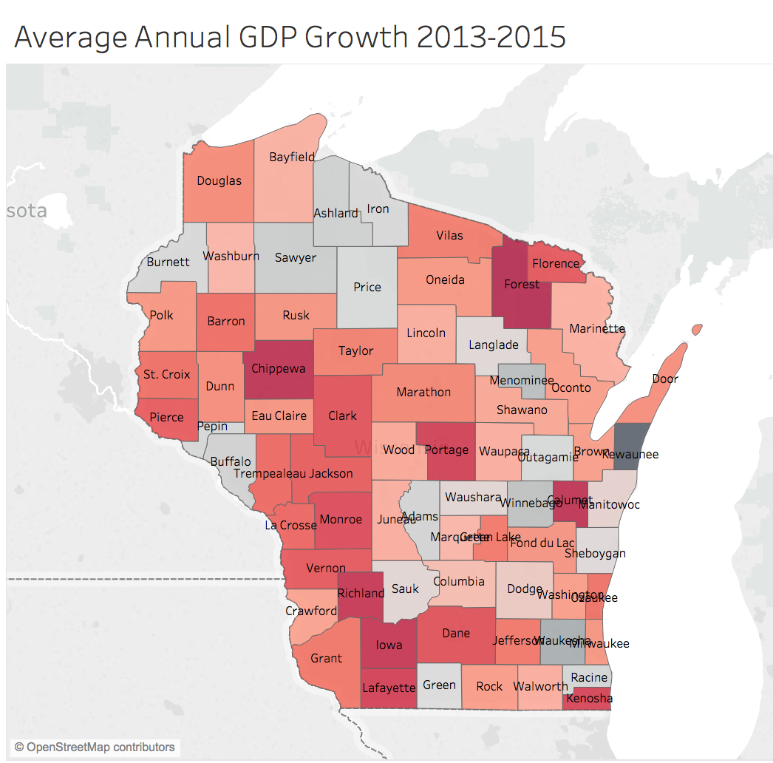
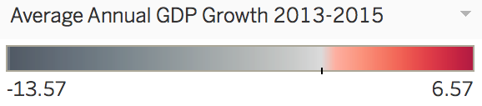
Source: Bureau of Economic Analysis

Slide 4
Source: WSJ Economic Survey January 2019
Notes:
If not this year, then next year- Mark Zandi, Moody’s Analytics

Slide 5
2018 Avg: 13.1%
2019 Avg: 24.8%
Source: WSJ Economic Survey January 2019
Notes:
A wide range of opinion here.
Two consecutive quarters of negative

Slide 6
Source: Bureau of Economic Analysis
Notes:
Constrained by labor market?

Slide 7
Source: St. Louis Federal Reserve- FRED
Notes:
The Census Bureau's definition consists of 12 states in the north central United States: Illinois, Indiana, Iowa, Kansas, Michigan, Minnesota, Missouri, Nebraska,North Dakota, Ohio, South Dakota, and Wisconsin.

Slide 8
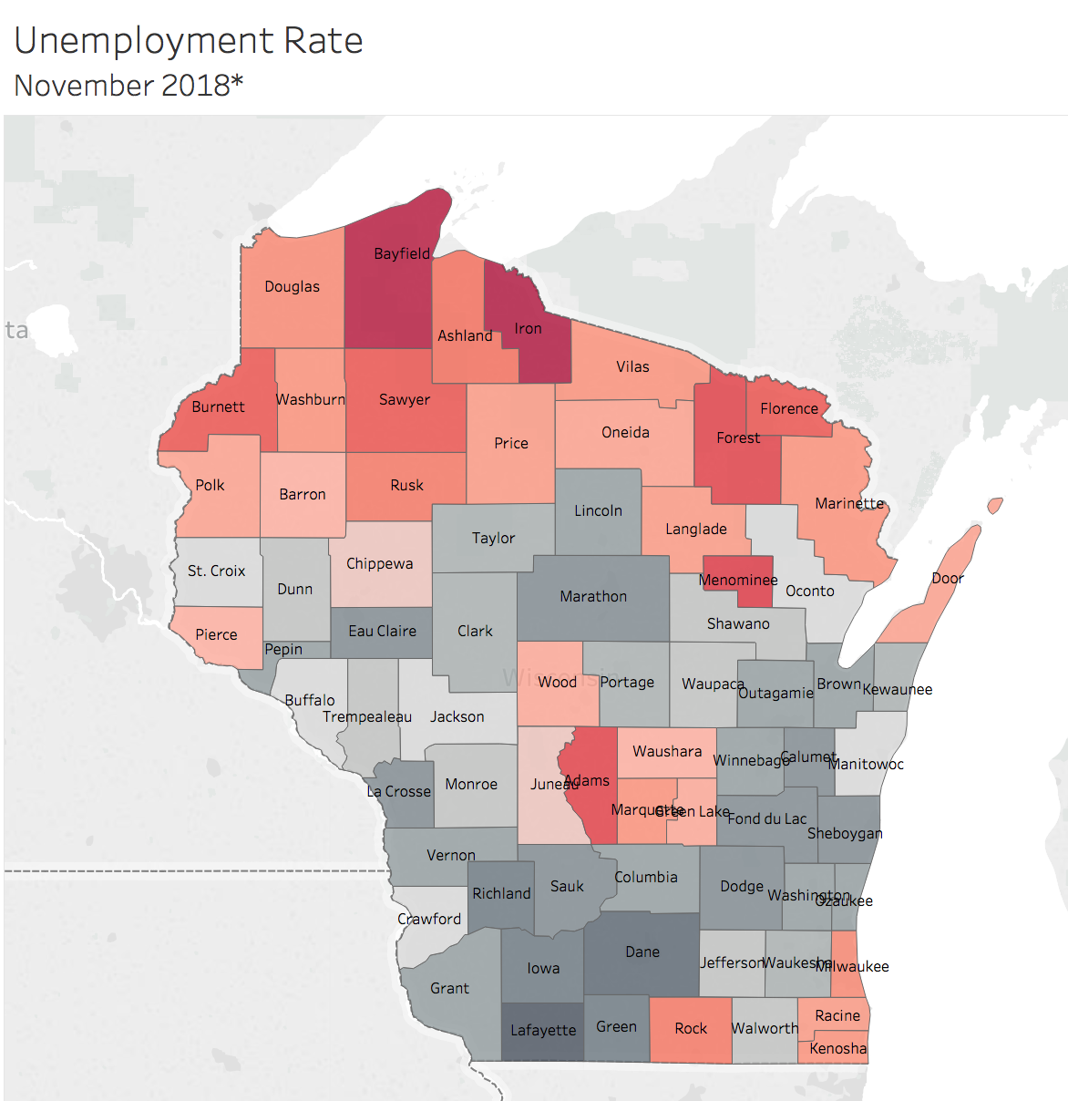
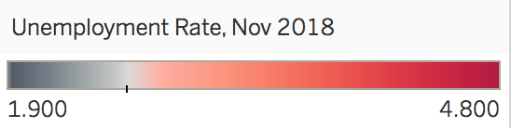
Source: Bureau of Labor Statistics

Slide 9
The ratio of unemployed to job openings reached a historical low in August 2018 at .74.
Source: Job Opening and Labor Turnover Survey (JOLTS)
Notes:
Labor constraint

Slide 10
Source: QCEW, Average Weekly Wage, All Industries-Total Private, Annual
Notes:
Wisconsin
Preliminary (2 quarters of data) from 2018.

Slide 11
Source: Bureau of Labor Statistics

Slide 12
Source: WSJ Economic Survey January 2019

Slide 13
Source: Bureau of Economic Analysis
Notes:
Stock

Slide 14
Source: Bureau of Labor Statistics
Notes:
Flow
More and more of this type of data coming out.

Slide 15
Source: WSJ Economic Survey, St. Louis Federal Reserve- FRED

Slide 16
Effective
Projected Target
Source: WSJ Economic Survey, St. Louis Federal Reserve- FRED
Notes:
Bank to bank loan.
Banks have to have a certain amount of cash reserves. Some banks have more and have less, so they lend to each other.
The FED sets that rate and it tends to ripple through commercial and industrial rates.
Raising interest rates to control inflation. But we haven’t seen high inflaiton.

Slide 17
Tessa Conroy
Assistant Professor and Economic Development Specialist
Division of Extension
UW-Madison
tessa.conroy@wisc.edu

