Slide 1
Dairy Consolidation:
A Processor perspective
Wisconsin Agricultural Outlook Forum
January 29, 2019
Sue Taylor
VP, Dairy Economics & Policy
Leprino Foods Company

Slide 2
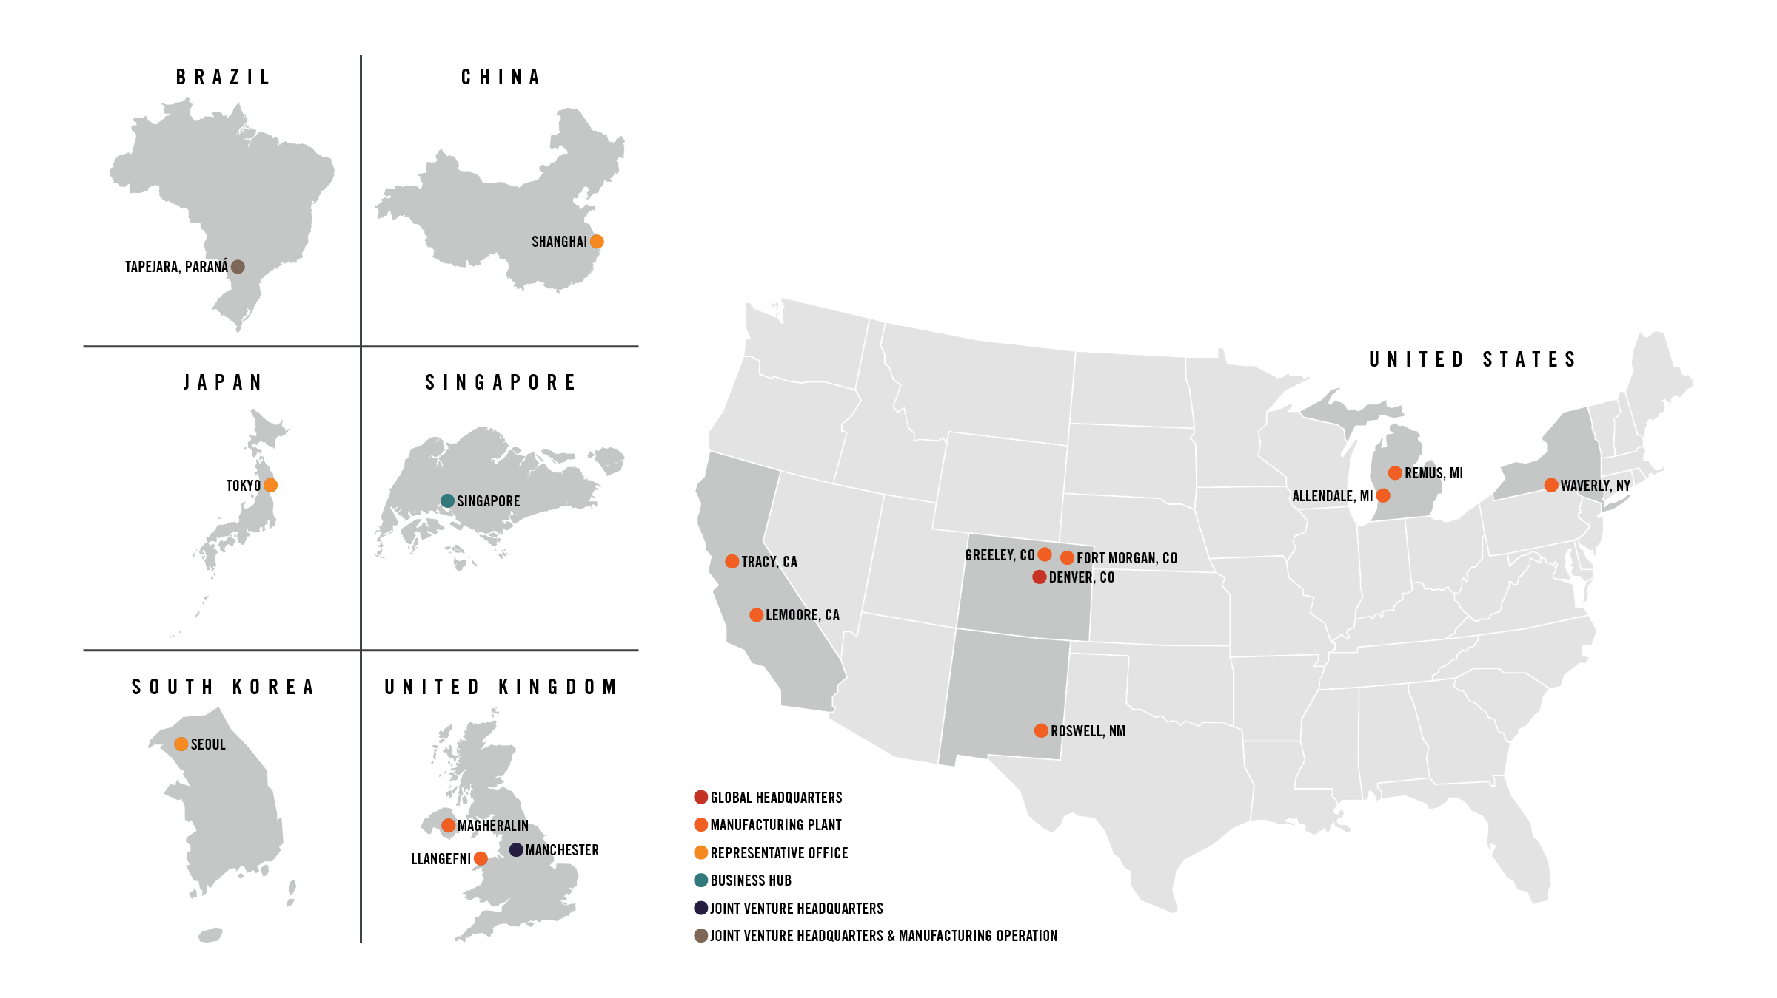
Leprino’s Global Footprint
Primary production in US with JVs in UK & Brazil
Our products are found in 50+ countries
We employ over 4,000 people worldwide
Notes:
Not speaking on behalf of LFC but perspectives informed by experience
LFC profile
Prior history

Slide 3
manufacturing sector not immune to consolidation
Data Source: USDA NASS Quick Stats
Notes:
Significant consolidation in manufacturing & development of larger specialized cheese plants
Largest plant when joined company 24 years ago processed 3 MM pounds milk per day
Today, largest processes 11 MM pounds
Significant pressure in B to B space to capture economies of scale

Slide 4
But, there’s room for smaller plants
Data Source: USDA NASS Quick Stats
Notes:
Significant consolidation in manufacturing & development of larger specialized cheese plants
Largest plant when joined company 24 years ago processed 3 MM pounds milk per day
Today, largest processes 11 MM pounds
Significant pressure in B to B space to capture economies of scale

Slide 5
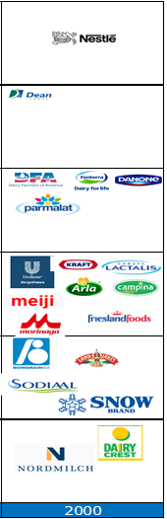
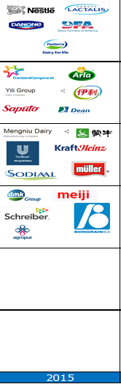
Top 20 dairy companies - historical perspective
Source: Rabobank

Slide 6


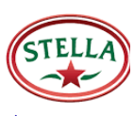



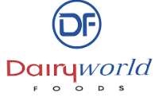






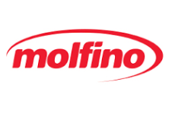
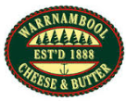
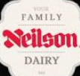
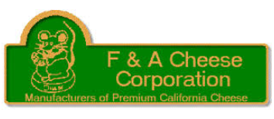

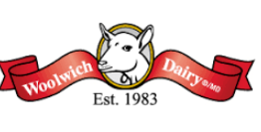

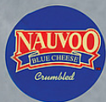

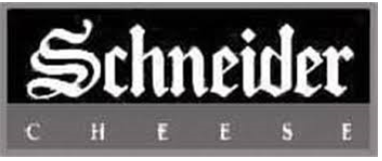
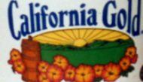
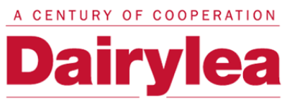

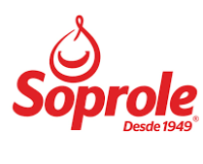











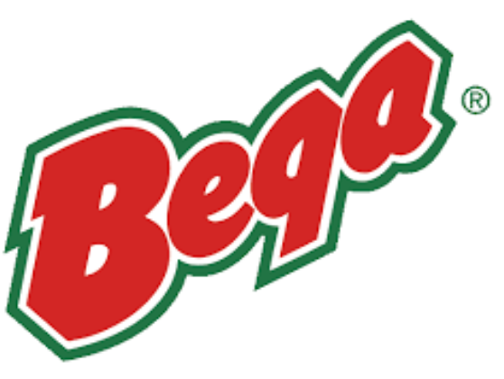

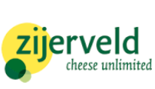












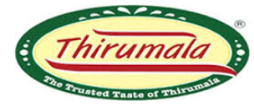






LoL Tulare
Cayer-JCB Group
AMPI Southern
Valley of Virginia Milk
Independent Coop Milk Prod. Assn.
Black Hill Milk Producers
Fromage Cote SA
NZ Dairy Group
Twee Provincien
Kiwi Cooperative Dairies
Milchwerke Köln/Wuppertal
IDB Belgium N.V.
G. Den Hollander Holding BV
Anika Foods Russia
DEK srl Italia
Ivory Coast

Slide 7



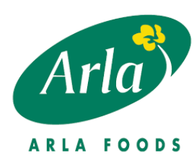
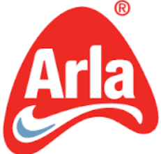
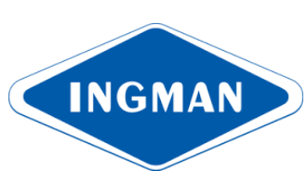

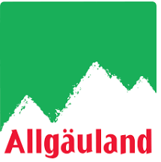
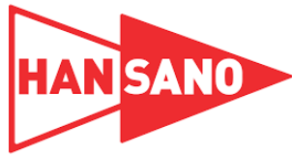

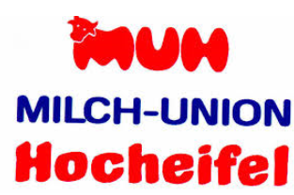


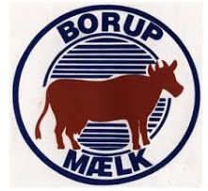

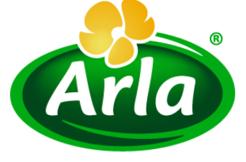

1989
Associated Fresh Foods UK
Danmark Protein
Hellevad Omegns Andelsmejeri
National Cheese Company
2012

Slide 8
What are the implications?
Milk marketing / procurement structures
  Role of cooperatives
Market specialization to address segmentation
  Coordinated supply chains to target consumer groups with specific preferences
  Segmentation to address different markets
    Undifferentiated
    Differentiated
    Pharma
Ownership models

