Slide 1
2019 Wisconsin Agricultural Outlook Forum
10:00-12:30: Agricultural Situation and Outlook
Farm Income and the New Farm Bill, Dairy, Grains and Livestock, Specialty Crops and Wisconsin Economy
12:30-1:30: Lunch
1:30-4:00 Dairy Consolidation: New Perspectives for
America’s Dairyland
Marin Bozic, Pete Kappelman, Bill Curley, Sue Taylor, and Mark Stephenson
https://renk.aae.wisc.edu/ag-outlook-forum/
Livestream: https://www.youtube.com/user/uwipm
#WiAgOutlook

Slide 2
Thank You to Our Sponsors

Slide 3
Farm Income and the New Farm Bill
Paul D. Mitchell
Professor, Agricultural and Applied Economics
Extension Specialist, Cropping Systems Management
Director, Renk Agribusiness Institute
Wisconsin Agricultural Outlook Forum
January 29, 2019 Madison WI
608-265-6514, pdmitchell@wisc.edu, @mitchelluw

Slide 4
Overview
1) Farm income projections for 2018 (down again)
2019 another year of tight margins, but signs of improvement
2) Mixed signals on the state of the farming sector
A Tale of Two Farms
3) 2018 Farm Bill
Crops: some new program tweaks
Market Facilitation Program: provided short-term help
Dairy program changes should help WI farmers

Slide 5
$93 B
-8%
$66 B
-12%
Source: https://www.ers.usda.gov/topics/farm-economy/farm-sector-income-finances/highlights-from-the-farm-income-forecast/

Slide 6
Total up 1.5%
Corn up 4.1%
Soybeans up 4.6%

Slide 7
Total down 0.2%
Beef Down 1.4%
Dairy Down 7.1%

Slide 8
Government Payments up 18%
Price/Revenue-based payments ARC/PLC -$4.6 B
Market Facilitation Program (MFP): +$4.7 B
Disaster Payments +1.6 B
MFP & Disaster
ARC & PLC

Slide 9
Expenses up 4.2%
(interest, fuel, feed & labor)

Slide 10
Wisconsin Net Farm Income in 2010-2018F
$1.7 B
-6%
Good production year, but income depends on prices

Slide 11
Wisconsin Land Values Up 2.3% in 2018
(Up 9.5% in 2017, 2nd highest in US)

Slide 12
State Average Cropland Rental Rate ($/A) up 0.7% in 2018

Slide 13
Projected Dairy Margins into 2019
https://dairymarkets.org/MPP/

Slide 14
Historical and Projected Margins ($/bu) for Corn and Soybeans in Iowa (as of Jan 2019)
WASDE | 2018 | 2019
Corn | 3.60 | 3.90
Soybean | 8.60 | 8.75

Slide 15
Wisconsin Led the Nation in Chapter 12 Bankruptcy Filings for 10/1/17 to 9/30/18
http://www.uscourts.gov/statistics-reports/caseload-statistics-data-tables

Slide 16
Current WI Farm Bankruptcy Rate Unusually High
Chapter 12 Bankruptcies per 10,000 Farms
State | 2016 | 2017 | 2018 | Average 1997-2016
Wisconsin | 5.82 | 6.57 | 6.86 | 2.98
Michigan | 4.09 | 3.14 | 1.77 | 2.98
Dinterman et al. (2018) https://aede.osu.edu/sites/aede/files/publication_files/FarmBankruptciesPaper.pdf

Slide 17
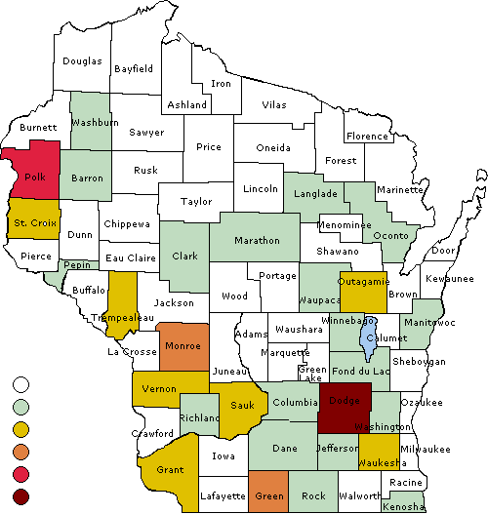
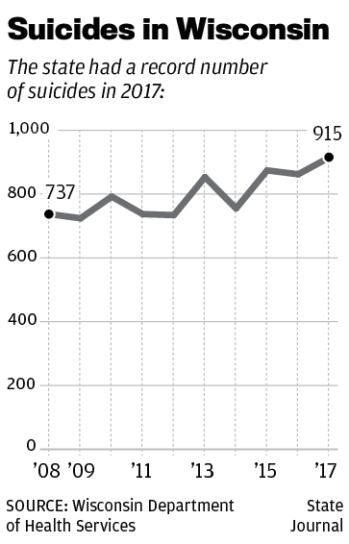
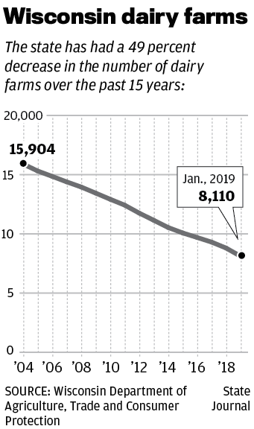
Chapter 12 Bankruptcy Filings by County (10/1/17 to 9/30/18)
012345

Slide 18
Chapter 12 Bankruptcy Filings by County (10/1/17 to 9/30/18)
A Tale of Two Farms: “It was the best of times, it was the worst of times, … it was the season of Light, it was the season of Darkness, it was the spring of hope, it was the winter of despair, we had everything before us, we had nothing before us …” (Dickens 1859)
012345

Slide 19
2018 Farm Bill Commodity Support: Loan Rates Increased
USDA-FSA Marketing Assistance Loans
Low interest loans (1%-point above federal rate) using harvested grain as collateral based on the loan rate
Useful for managing short-term cash flow after harvest, especially now as interest rates increase
Loan Rate | New | Previous
Corn | $2.20 | $1.95
Soybean | $6.20 | $5.00

Slide 20
2018 Farm Bill Commodity Support: PLC and ARC Changes
Update payment yields using 2013-2017 yield data
PLC Reference Prices: $3.70 for corn, $8.40 for soybeans
Now PLC Effective Reference Price: same floor, but can “float” higher to 85% of 5-Year Olympic Average
No PLC price changes until market prices increase
ARC: Small changes to increase county revenue guarantee, so higher & more accurate county guarantees
Do not expect large ARC payments in 2019 for the 2018 corn and soybean crops

Slide 21
2018 Farm Bill Commodity Support: Program Selection
Previously locked into ARC or PLC for life of the Farm Bill
2019 & 2020 combined: elect ARC or PLC by crop
2021 and beyond: ARC vs PLC an annual election by crop
Recommended choice will depend on national price expectations and your county’s ARC revenue guarantee, but many expect a big move to PLC

Slide 22
Impact of Market Facilitation Program (MFP) on Commodity Support Payments in WI
Estimated MFP Maximum: $217M
Year Paid
Payments based on production, not base acres
Soybeans $1.65, Wheat $0.14, Dairy $0.12, Corn $0.01
Sign-up deadline extended due to shutdown

Slide 23
2018 Farm Bill Commodity Support: Dairy Margin Coverage (DMC)
Margin Protection Program (MPP) for dairy was ineffective and unpopular, replaced with DMC
1st 5 million lbs: Higher margin (up to $9.50) for $0.10 to $0.15/cwt, cover 5%-95% of historical production
Can choose different margin for production above 5 million lbs, with lower costs for $4-$5 margin (≤ ½ cent/cwt)
Can combine DMC with new Dairy Revenue Protection (DRP) insurance policy
Choose $8.00-$9.50 margin for your first 5 million lbs, then $4-$5 for higher production and maybe buy DRP
Will help smaller dairies

Slide 24
Summary
Farm income for 2018 down slightly and 2019 will be another year of tight margins and income uncertainty
Farm Bill will help dairy, MFP provided short-term help
A Tale of Two Farms: Some farms are doing okay, but many farm families are financially and emotionally stressed after several years of low income and tight margins
DATCP Farm Center: 1-800-942-2474
https://datcp.wi.gov/Pages/Growing_WI/FarmCenterOverview.aspx
Helping Tame Farm Stress (for Ag Professionals)
http://nasdonline.org/static_content/documents/7400/farmstress-a-ash-103-top10listpdf.pdf
Farm Stress & Decision Making During Challenging Times
http://www.agsafety.info/2016/12/farm-stress-decision-making-during.html

Slide 25
Thanks for your Attention
Paul D. Mitchell
Professor, Agricultural and Applied Economics
Extension Specialist, Cropping Systems Management
Director, Renk Agribusiness Institute
608-265-6514, pdmitchell@wisc.edu, @mitchelluw

