Slide 1
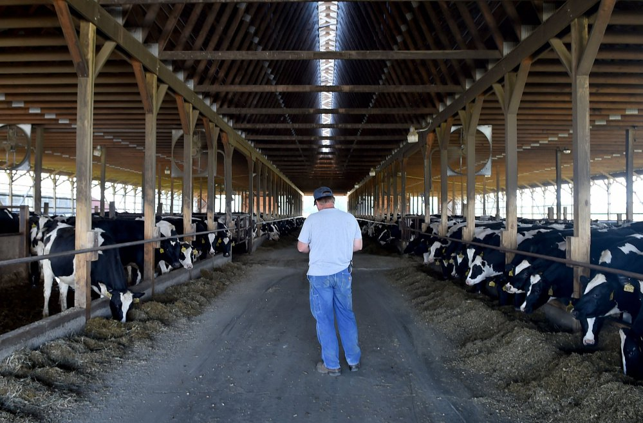

2018 Dairy Situation & 2019 Outlook
Wisconsin Agricultural Outlook Forum
Mark Stephenson, Ph.D.
Director of Dairy Policy Analysis

Slide 2
The Economy Has Been Strong
Notes:
The general economy has been strong. Unemployment has been at historically low levels of 3.7% for the last three months and labor is hard to find. Despite that, there are a few signs that we may take a bit of the steam out of this happy story.

Slide 3
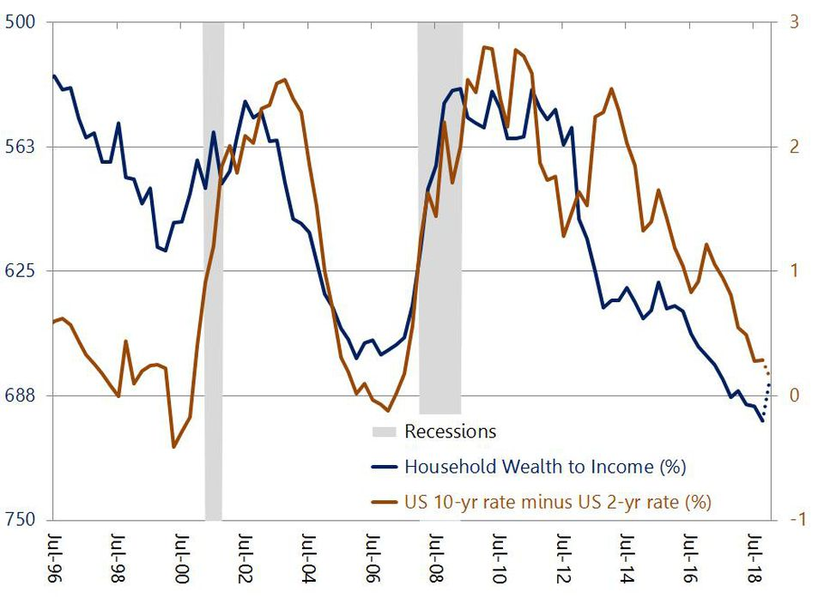
Comments on the General Economy
Notes:
These two indicators have been good predictors of recessions. In the blue line, when wealth (assets like stocks or real estate) grows much faster than income, it is an indication that the economy is not benefiting people the same. People who cannot save will not be able to purchase as much. In the brown line, you want long-term interest rates to be much higher than short-term rates—that is an indication of a positive view of the future. An inversion where short-term rates are actually higher, is almost a guarantee of problems. Both of these indicators are strongly hinting at recession.

Slide 4
Consumer Confidence
Notes:
Consumer Confidence in the economy is a two-part survey asking questions about “how do you feel about the present situation” and “how do you feel about the near future”. When they are divergent with the present well above the future, it is also indicative of a consumer who is going to spend less.

Slide 5
A Consumption-Based Economy
Notes:
Consumption is neither good or bad, but we are more inherently more vulnerable to economic downturns

Slide 6
The Importance of Dairy Trade
Notes:
Since the early 2000s our milk prices are closely linked to exports. Anytime that our exports have fallen off pace, our milk and dairy product production have overwhelmed our domestic markets. This slide shows the correspondence between a rolling 12 month export as a percentage of milk production compared to the US All Milk price. I don’t think that we will see significant milk price improvement until trade accounts for about 17-18% of exports. We are getting closer, but probably not through most of 2019.

Slide 7
U.S. Cheese Stocks
Notes:
When exports are off trend, we first begin to build stocks which push down on product prices and then on farm milk prices. This certainly happened in 2009 but it also has happened over the last few years. This hasn’t been as deep a price drop as 2009 because these products have stayed home in a strong economy this time, but it has been much longer.

Slide 8
Milk Prices Have Been Range-Bound
Notes:
We are entering our 5th year with farm milk prices in the $16-18 range and we can’t seem to break out of it. We really need to move into the $18-20 range before it feels like recovery.

Slide 9
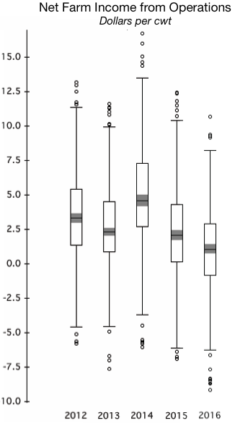
Why Has the Trough Persisted?
We see a $10 range every year in the cash costs of production on WI dairy farms.
20% of farms have cash flowed right through this trough
30% have had to borrow more
30% have had to restructure loans
20% are in real trouble.

Slide 10
How Bad Is It?
Notes:
A “normal” attrition rate is about 3-4%. This year it is above 7%.

Slide 11
Why the Long Trough?
Notes:
Last year (2017) the EU had very strong production. This year, NZ is having the strongest start to their season ever. There has been a lot of milk on world markets. The good news is that severe drought and low milk prices have slowed EU production. Weather may slow NZ’s production. U.S. production has slowed and cow numbers are declining.

Slide 12
Number of Cows

Slide 13
Milk per Cow per Day
Notes:
Milk per cow has held up well despite low milk prices. Feed costs have been relatively inexpensive, but will feed quality be a problem in 2019 when we get into poor quality silage? Will dairy farms want to purchase more concentrate to improve rations with low milk prices?

Slide 14
Percent Change in U.S. Milk Production
Notes:
Milk production increases have been contracting since 2016.

Slide 15
Dairy Products are a Good Buy
BLS —Dairy and Related Products
Notes:
Retail prices for dairy are the lowest since 2012 and milk-equivalent per capita consumption of all dairy products has increased.

Slide 16
Fluid Milk Sales Continue Slide
Notes:
Fluid milk continues its slide.

Slide 17
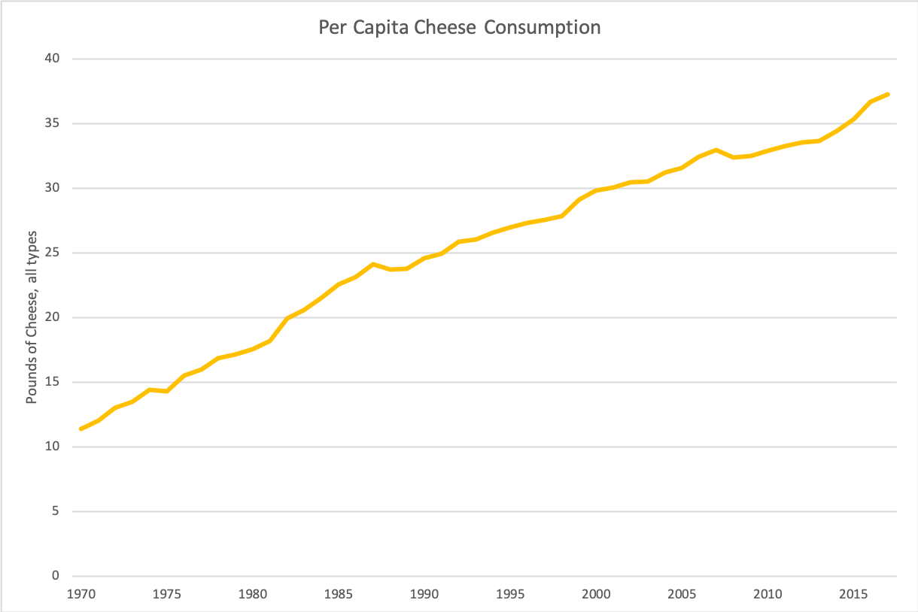
It’s Not All Bad News
Notes:
Per capita cheese consumption continues to climb to now about 37 pounds. Cheddar and Mozzarella are each about 30% with a variety of other cheeses making up the rest.

Slide 18
Global Dairy Trade Index
Some Optimism?

Slide 19
Intervention Stocks Overhang Markets

Slide 20
Despite Trade Tensions…
China’s per capita dairy consumption is still small and expected to grow (23 lbs compared to world average of about 111 and US average of 640).
China’s small dairies are exiting faster than mid-size and large dairies are growing causing milk production contraction.
China has historically purchased a lot of U.S. whey and we are re-negotiating trade (but we have stubborn leaders!)
USMCA has been signed with improved access to Canada
Mexico has started to purchase again.

Slide 21
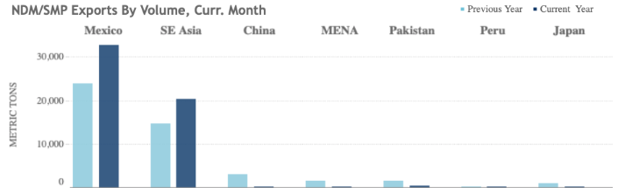
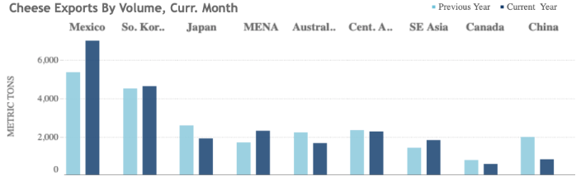
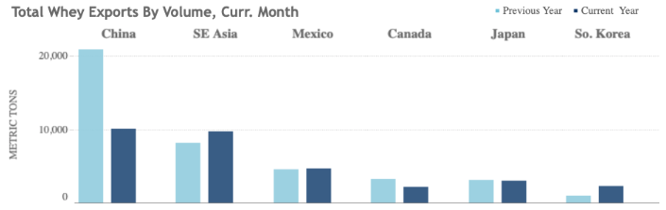
Change in Exports for October

Slide 22
Other Factors
Trade retaliation has had an impact
  Perception becomes reality—we lost $1.50-2.00 in futures
  Trade model suggests real impact should be more like 50-75¢
  Trade mitigation will pay producers about 4¢ on impacted milk
MPP will have paid about 62¢ per cwt on average on first 5 million pounds of historic production (at the $8 level)
Some enthusiasm for new Dairy-RP product (11B under endorsements), but that can only undergird what futures markets expect.
DMC looks very promising—especially for smaller dairies.

Slide 23
Price Forecasts
Notes:
My price forecasts are for milk price improvements on through 2019 from our 2018 lows. This is not for anything like 2014 levels, but it will probably feel a lot like 2017 prices did. I’m expecting an average price improvement of about $1.25 from 2018.

Slide 24
Outlook Contributing Factors
Positive Factors
Negative Factors
Slowing US and World milk production
Declining world stocks
Relatively strong domestic economy
Trade improvements
El Niño
New Zealand production
Slow GDP growth in some countries like China
Prolonged trade negotiations
Possibility of US recession

Slide 25
My Forecast…
Unless circumstances change significantly on the export side, it’s hard to be overly optimistic about milk prices in 2019.
  I don’t think that milk prices will feel “good” until exports represent about 17-18% of milk of milk production on a rolling average 12 months.
I am forecasting 2019 Class III up by 80¢, Class IV up by $2.15 and the All Milk Price up by about $1.10 (reflects weak premiums). Basically, 2019 will feel better than last year but not quite as good as 2017.
We are losing more farms, but not our capacity to produce milk.
Is this the new “normal”?

Slide 26
Questions?

