Slide 1
Dairy Consolidation: Causes and Solutions
Wisconsin Ag Outlook Forum
Madison, WI
January 29, 2019
Dr. Marin Bozic

Slide 2
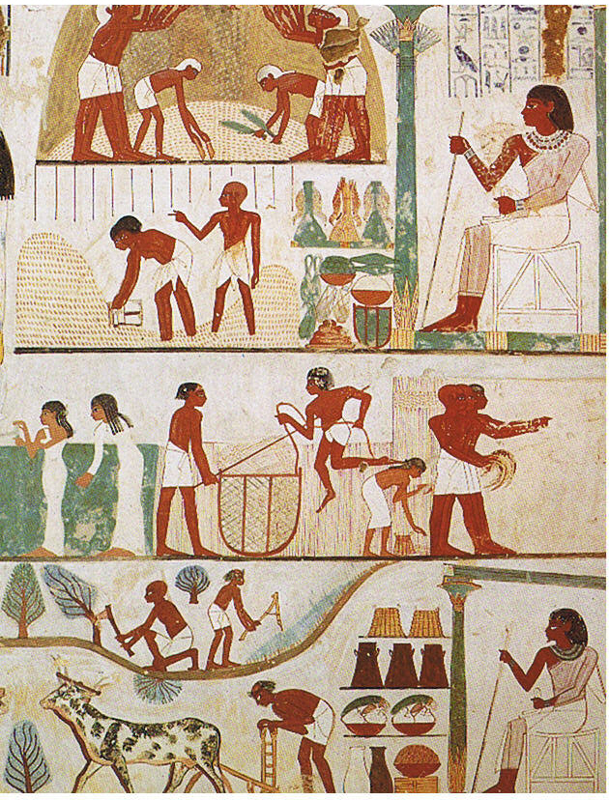
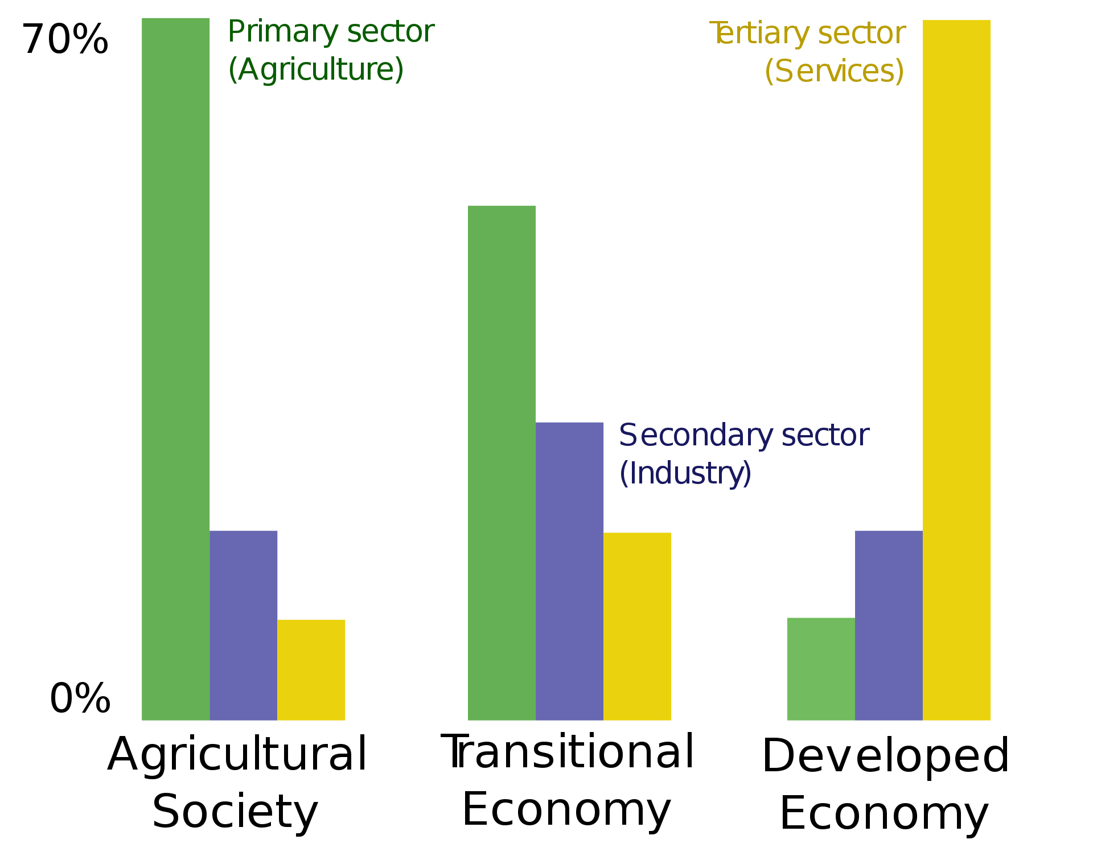
Agricultural ‘consolidation’ is as old as the civilization itself
2
Agricultural surplus meant there was enough food around to feed soldiers, priests, artisans, government…
So why are we lamenting consolidation?
Notes:
EU Quotas lifted
Chinese Import demand grew rapidly mid 2013-mid 2014, raising dairy prices and spurring producer expansion globally
Dairy processing capacity was expanded in EU and NZ to handle the growth
Developing countries growing demand for dairy was increasingly evident, especially while 3rd world counties were experience high income growth rates

Slide 3
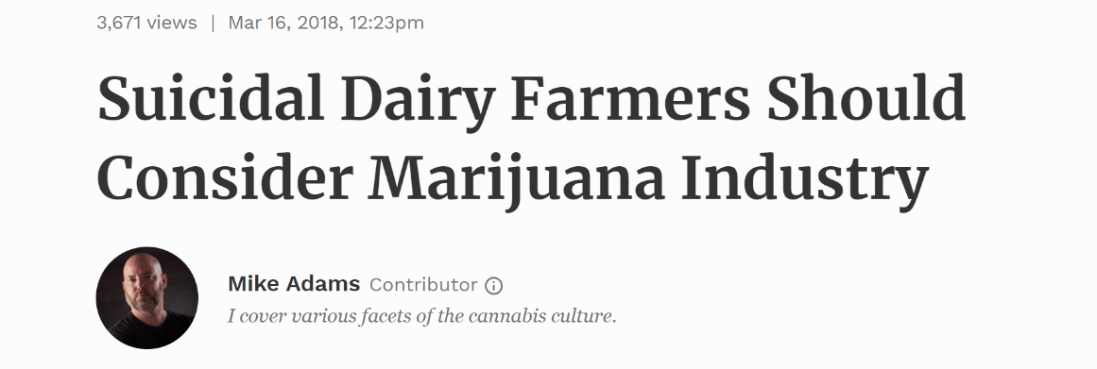
2018 – the year that broke the dam
3

Slide 4
Consolidation pace over time
4
2018 WI Exit Rate

Slide 5
5
Implications of Cow Productivity Gains vs. Population Growth Rate

Slide 6
Why was the herd stable since 2000?
6

Slide 7
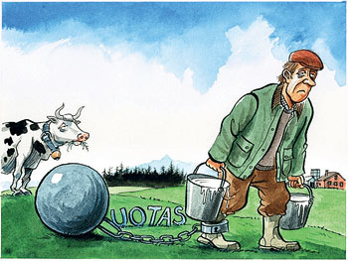
Golden era of U.S. exports lasted until 2015, when EU abolished milk quotas
7
Exports growth as % of milk production growth
Period | Milk-Fat Basis | Skim-Solids Basis
2007-2017 | 13% | 59%
2007-2014 | 34% | 79%
2014-2017 | -31% | 18%
To keep the U.S. dairy herd stable, U.S. needs to exports 40-50% of incremental skim solids (protein & lactose). The single
most important reason why U.S. dairy producers did not enjoy decent profit margins since 2015 are languishing exports.
Without exports, markets need to depress the milk price sufficiently to incentivize herd contraction.

Slide 8
Geopolitics of trade
8
Preferential Dairy Access – Selected Markets
 | U.S. | EU | NZ | Australia
Mexico |  |  | * | *
Canada |  |  | * | *
China
South Korea
Japan |  |  | * | *
Indonesia
Malaysia
Vietnam |  |  | * | *
Thailand
Mercosur
Chile
Colombia
Concluded FTA (implemented or pending near-term implementation)
Negotiating FTA, with potential dairy access
Re-negotiating FTA
* - Negotiations via TPP
Source: Al Levitt, USDEC

Slide 9
Exports to Mexico and China
9

Slide 10
Exports to Mexico and China
10

Slide 11
Exports to Mexico and China
11

Slide 12
Energy & food independence + robots relieving labor constraints → U.S. national interest may be perceived by current administration as inducing global disorder
12
Net energy trade
quadrillion British thermal units

Slide 13
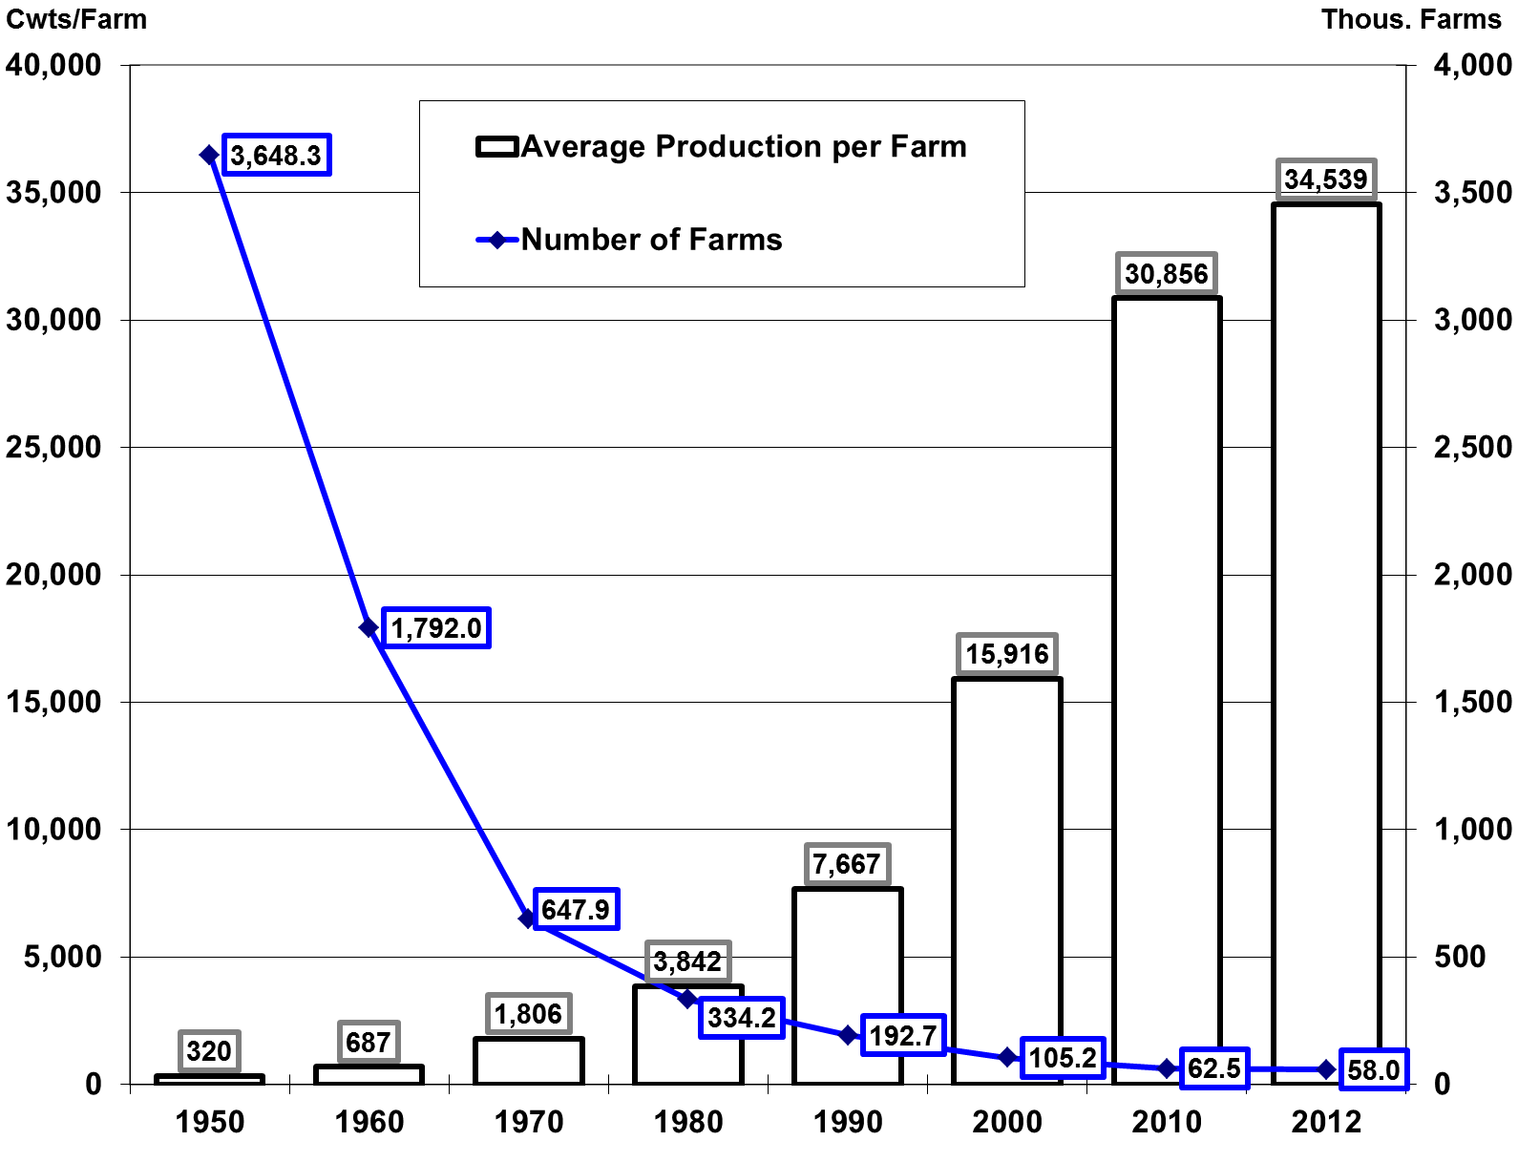
13
The number of dairy farms drops 40-50% every decade, while
average farm size about doubles

Slide 14
Changes in size and management/financing model
14
“large farms” → multi-site dairy agribusinesses
“family ownership” → non-family partnerships
external equity financing → no longer relying solely on retained earnings for expansions
No longer constrained to one milkshed → necessary to escape local processing capacity constraints
Larger % of milk by dairies that are not ‘last-generation’ dairies → exists are increasingly involuntary
100-200:
1997 / 20%
200-500:
2000 / 18%
2000+:
34.7% and Rising
500-1000:
2005 / 14.3%
1000-2000:
2007 / 16.1%

Slide 15
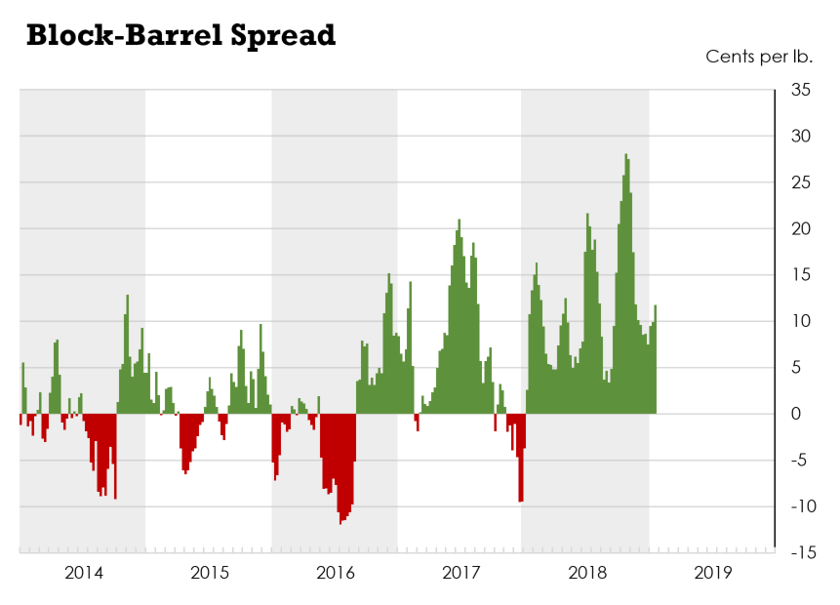
Block-Barrel Spread has hurt Upper Midwest dairy producers
15

Slide 16
Ways out?
16
Combine on-farm work with off-farm entrepreneurship that does not require you to physically leave the farm
Outstanding cow and cost management still makes a big difference for small/medium farms
Growth through lateral partnerships
Income subsidies
Mandatory national supply management
Different ownership-based career in agriculture: emerging crops (e.g. hemp)

Slide 17
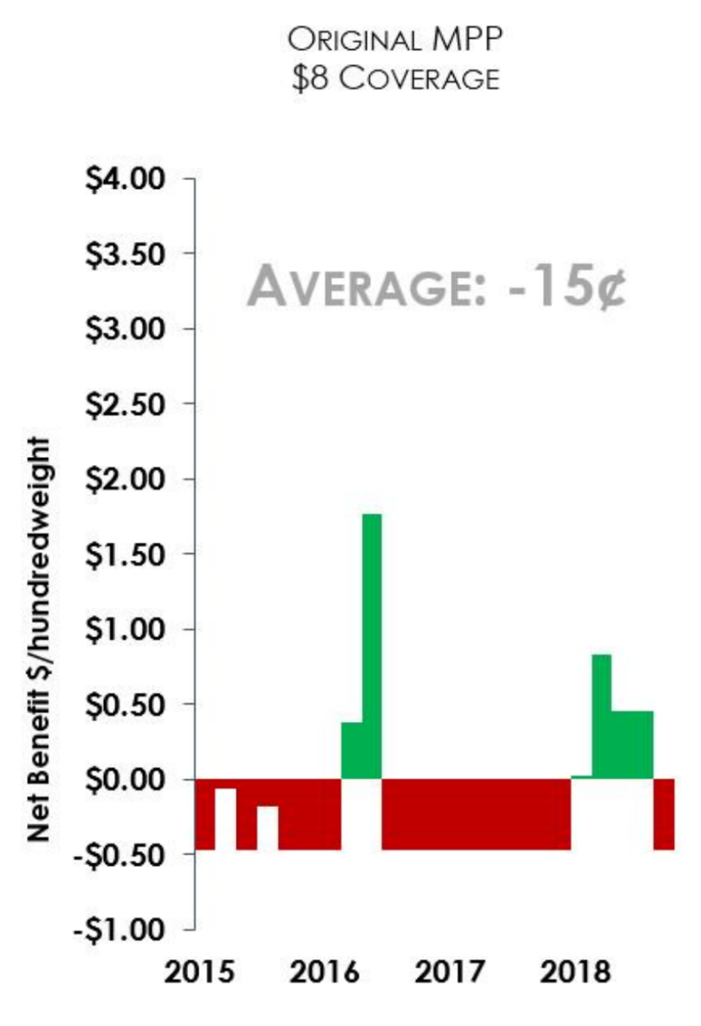
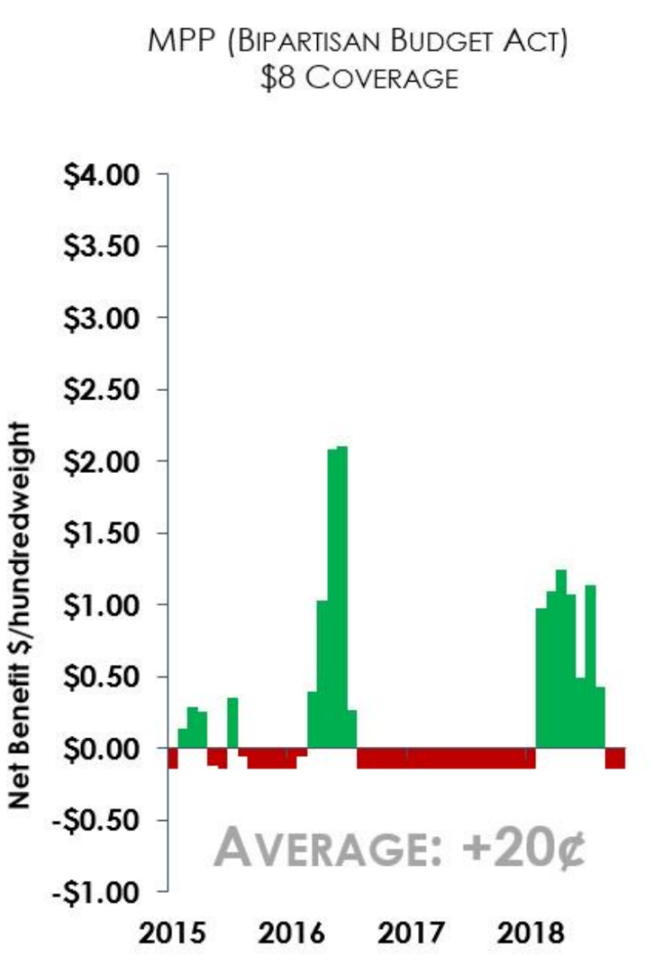
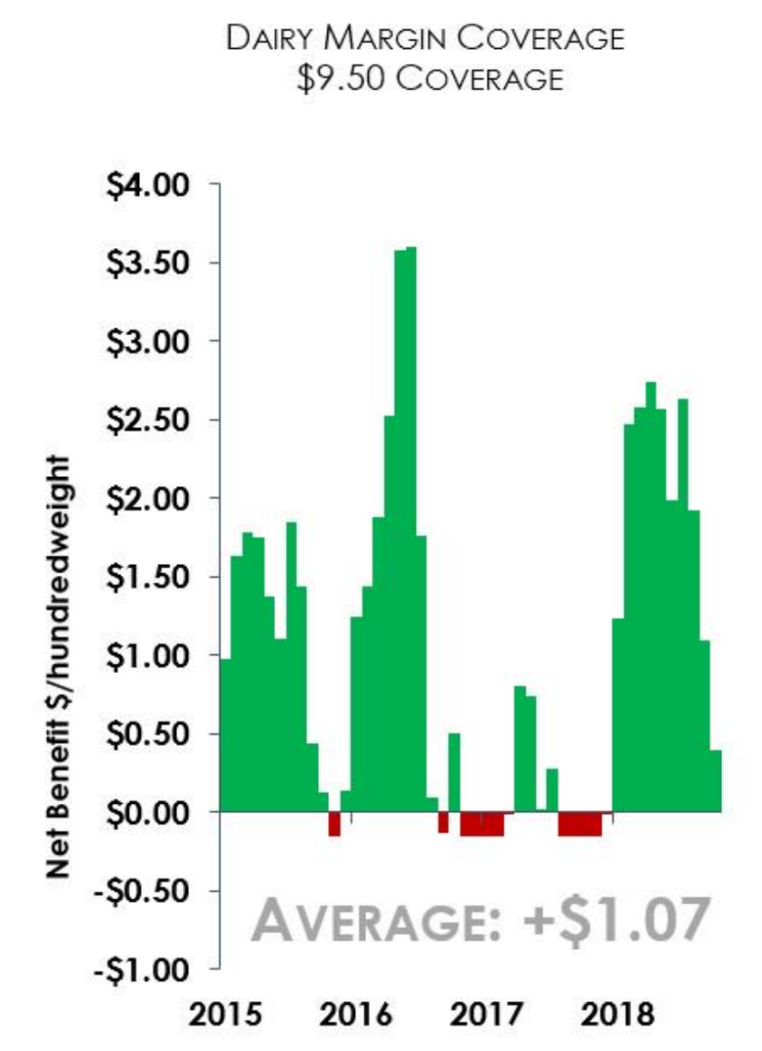
Dairy Margin Coverage is a massive improvement over MPP

Slide 20
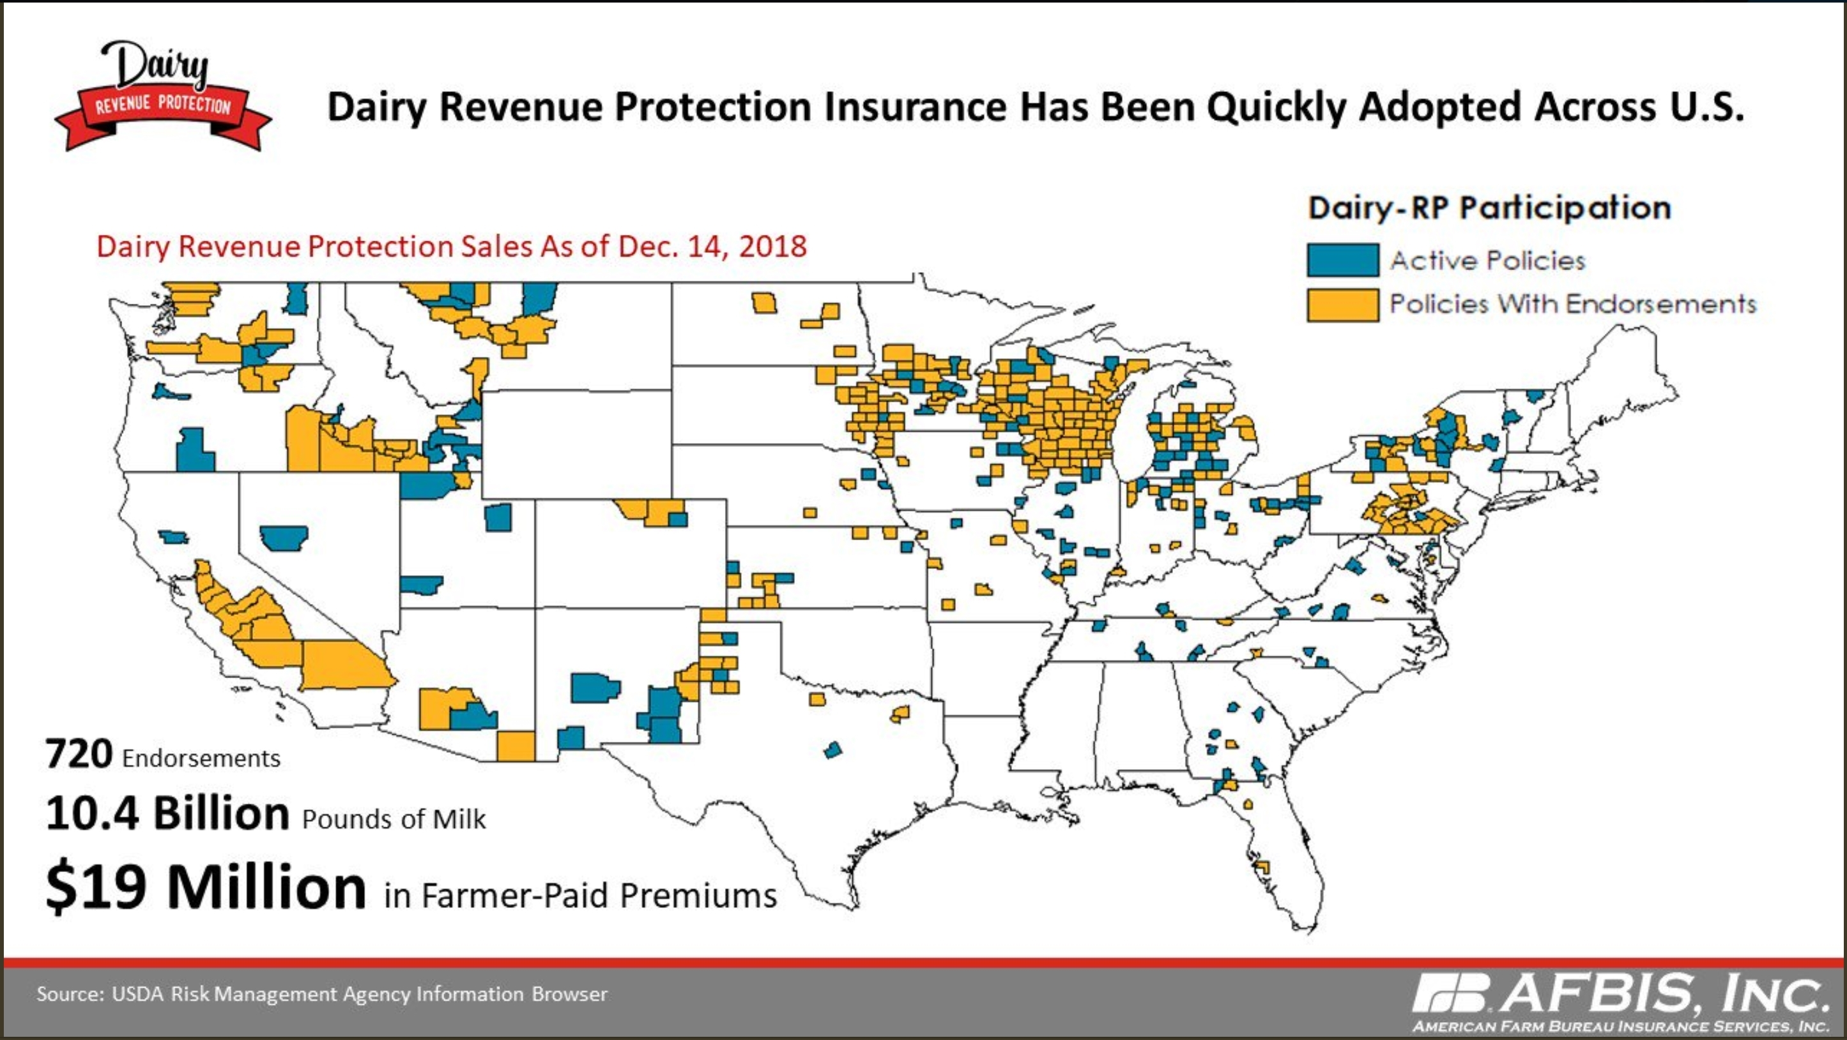

Slide 21
Premium subsidies
21
Area-Based Revenue Protection Subsidy Schedule from FCI Act 2014
Coverage Level | Premium Subsidy
90% to 95% | 44%
85% to 89% | 49%
75% to 84% | 55%
70% to 74% | 59%
Below 70% | N/A
Premiums are not due until the quarter of coverage is over.
For example, premiums for Q1 2019 are not due until April 15, 2019.

Slide 22
Tough times don’t last…
22
Productivity gains, changes in dairy production models, liberalization of milk production in EU and trade disorders are factors driving consolidation in U.S. Three of those four factors will continue to stimulate higher-than-historical consolidation.
Recent changes in U.S. dairy safety net will likely slow down U.S. consolidation rates in Q3 2019 and later (possibly as early as Q2)
As small dairy farms (under 300 cows) start feeling less pressure to exit, medium-size farms (500-2000 cows) will carry more of the burden for matching supply and demand, and we may see higher exit rate in this category.
Adverse block – barrel spread will continue to burden Minnesota, and to some extent Wisconsin dairy sectors – regional exit rates likely to stay higher than national.
The proverb says: “Tough times don’t last, tough people do.” Toughness is a great fuel, but it needs the engine of resourcefulness, and sustainable identity for chassis.

Slide 23
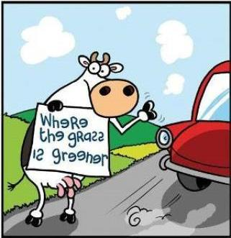
Thank You!
Dr. Marin Bozic
mbozic@umn.edu
Department of Applied Economics
University of Minnesota-Twin Cities
317c Ruttan Hall
1994 Buford Avenue
St Paul, MN 55108

