Slide 1
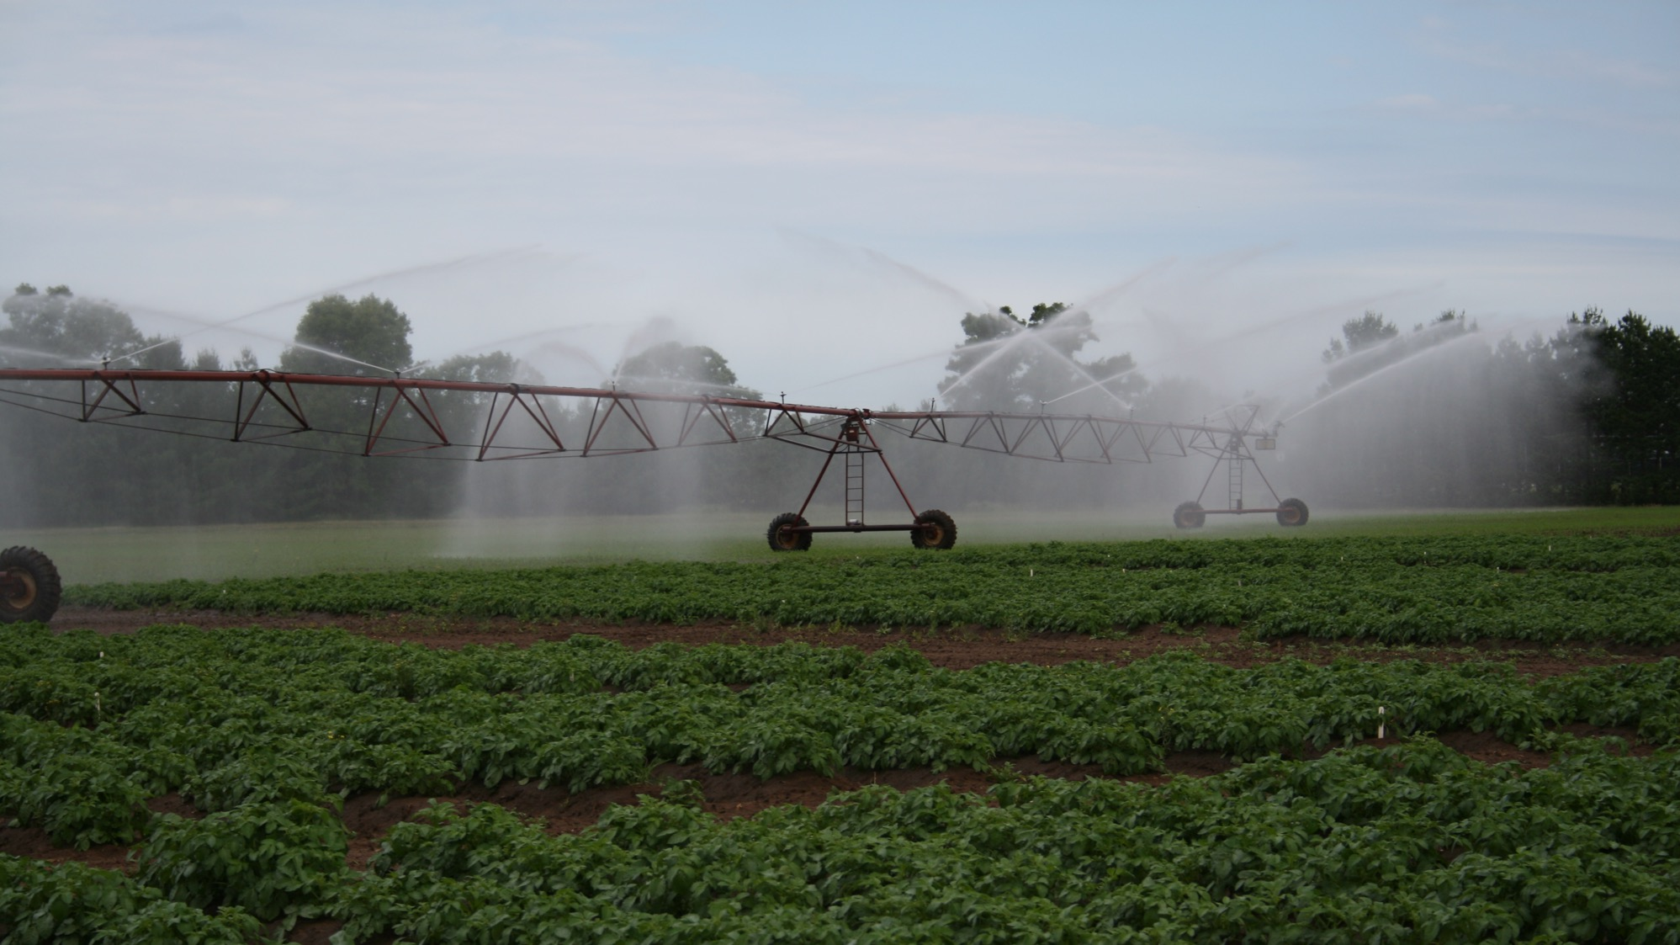
Specialty Crop Situation and Outlook
Jed Colquhoun
University of Wisconsin-Madison

Slide 2
Specialty crops are part of our rural glue
2013-2015 Average Industry | Total Revenue ($ million) | Total Economic Activity ($ million) | Total Jobs
Specialty Crop Production | $695 | $1,059 | 7,567
Potatoes | $271 | $413 | 2,922
Vegetables | $228 | $348 | 2,497
Cranberries | $158 | $241 | 1,735
Other Fruit | $38 | $58 | 413
Specialty Crop Processing | $2,822 | $4,781 | 16,981
Total Impacts | $3,517 | $5,835 | 24,538
A $5.8 billion dollar industry generating almost 25,000 jobs from 700 million dollars of raw fruit and vegetable products

Slide 3
The maximum is not the optimum
-Garrett Hardin, The Tragedy of the Commons

Slide 4
Economic impact of specialty crop industry in Wisconsin 2006-2008 versus 2013-2015
-9%
-8%
-29%
-32%
-3%
-24%

Slide 5
Prices continue to decline for almost all commodities, while production costs increase
Prices received | August 2017 | August 2018
Dry beans | $29.50/cwt | $26.30/cwt
Carrots, fresh | $28.90/cwt | $25.80/cwt
Sweet corn, fresh | $26.80/cwt | $24.40/cwt
Cucumbers, fresh | $16.00/cwt | $17.80/cwt
Onions, fresh | $13.60/cwt | $15.20/cwt
Potatoes, fresh | $14.61/cwt | $11.20/cwt
Apples | $0.426/lb | $0.297/lb
Strawberries | $84.70/cwt | $50.50/cwt
Corn | $3.27/bu | $3.36/bu
Soybean | $9.24/bu | $8.59/bu
Milk, all | $18.10/cwt | $15.90/cwt
Prices paid Index for commodities and services, interest, taxes and farm wage rates
Index | 105.7 | 108.7
Data source: USDA-ERS

Slide 6
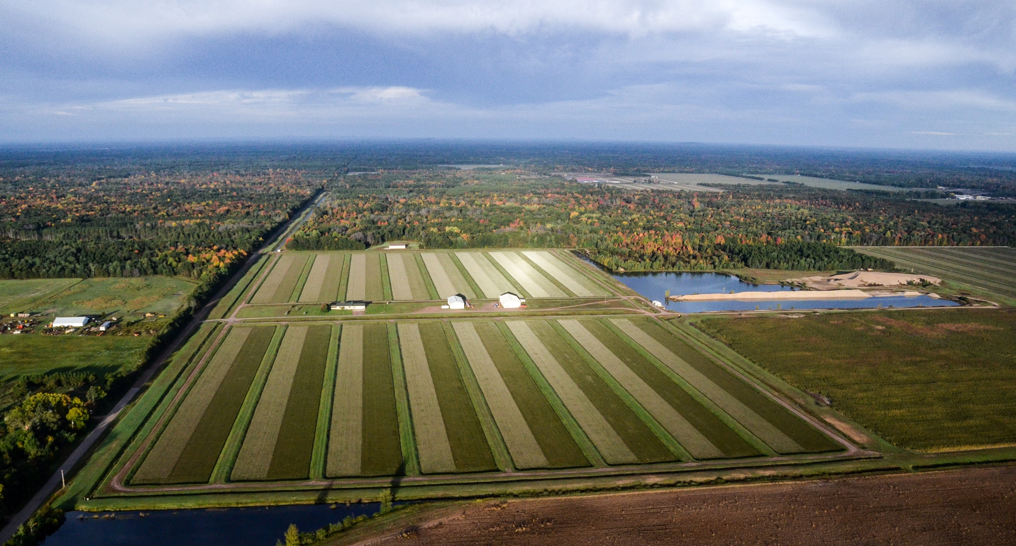

Slide 7
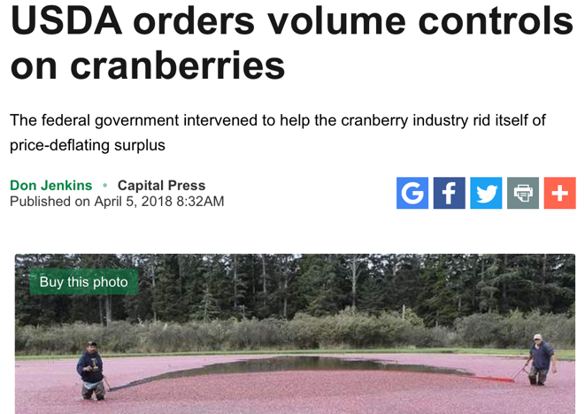
Cranberry acres increased, prices dropped and in 2018 national volume control is implemented
WI farm price: Down 39% since 2012
Harvested Acres
Farm Price $/barrel
Data source: USDA-NASS

Slide 8
Processing vegetables in Wisconsin (Sweet Corn, Snap Beans, Green Peas, Carrots, Cucumbers)
Year | Planted Acres | Value ($ million) | Value ($/Ac)
2011 | 194,300 | $174 | $894
2012 | 198,700 | $193 | $970
2013 | 184,300 | $251 | $1,361
2014 | 183,000 | $156 | $853
2015 | 179,400 | $156 | $869
2016 | 172,200 | $126 | $734
2017 | 157,300 | $119 | $754
Planted acres down 21% since peak in 2012
Crop value down 53% since peak in 2013
Data source: USDA-NASS

Slide 9
US per capita vegetable consumption has been declining since 1996 (total quantity) – Decrease in last 10 years: All 5%, Fresh 3%, Canned 8%, Frozen 10%
Data source: USDA-ERS

Slide 10
Canned snap bean consumption per capita and price have declined significantly
Data source: USDA-ERS

Slide 11
Meanwhile, yield per acre increases, more than making up for acreage decline
Data source: USDA-NASS

Slide 12
WI Potatoes: an example of successful volume management?
Data source: USDA-NASS

Slide 13
Consumers aren’t the only variability that presents risk and opportunities

Slide 14
2018 Headline: cold, wet weather delays planting, shortens harvest time and affects crop quality

Slide 15
Labor is becoming a major issue, everywhere

Slide 16
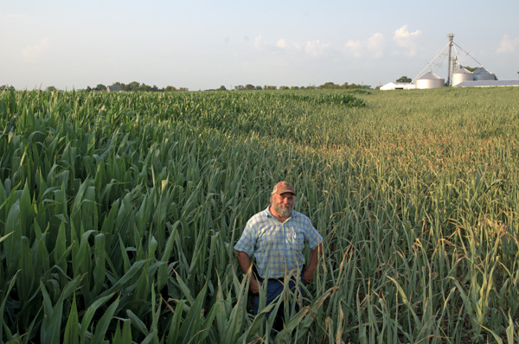
Well, that’s depressing… what can we do about it?
Specialty Crop Task Force:
Small group and individual meetings: growers, food processors, public agencies, commodity leadership, food innovators, retailers.
Learn about related successes, here and elsewhere: specialty meats, specialty cheeses, fermentation products (foods as well as breweries/distilleries), multi-ingredient convenience products.
Not to replicate what’s worked elsewhere, but to learn how they went about finding success
Compile and analyze information, propose a suite of potential options, share and seek feedback at a Specialty Crop Summit.

Slide 17
We have a transportation advantage
Proximity to East coast relative to West coast producers, particularly where rail transport is limited
There are 34 million mouths to feed in the Great Lake Basin
Over 20 million people within 200 miles of Wisconsin

Slide 18
We’re innovative

Slide 19
Hemp: an example of innovation and Wisconsin as a growth leader
Market development: grain, seed, CBD oil and fiber
DATCP registration/license update:
305 total hemp grower applications for a license and/or 2019 annual registration
248 are new applicants
57 are applying for a re-registration for the 2019 annual registration
191 total hemp processor applications for a license and/or 2019 annual registration
168 are new applicants
23 are applying for a re-registration for the 2019 annual registration
Photo: ilfb.org

Slide 20
Select photos courtesy Sevie Kenyon, UW-Madison

