Slide 1
Livestock and Grains Situation and Outlook January 2018
Brenda L. Boetel
UW-River Falls
Extension Commodity Marketing Specialist

Slide 2
Livestock

Slide 3
Meat production was up 2.5% in 2017 and will be up 2.8% in 2018
Broiler production up 2.1% (+1.8% in 2018)
Turkey production down 0.3% (-1.9% in 2018)
Pork production up 2.5% (+3.7% in 2018)
Beef production up 3.8% (+4.9% in 2018)

Slide 4
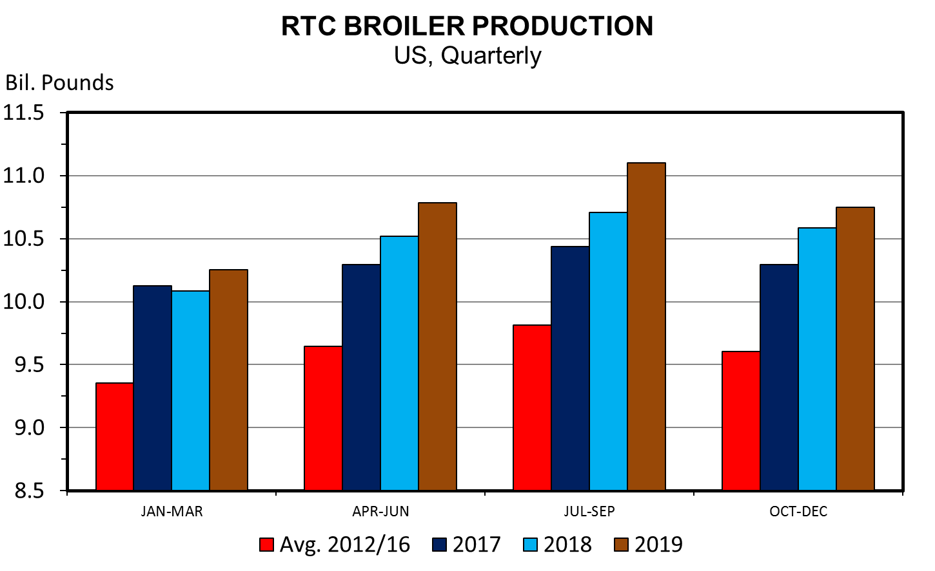
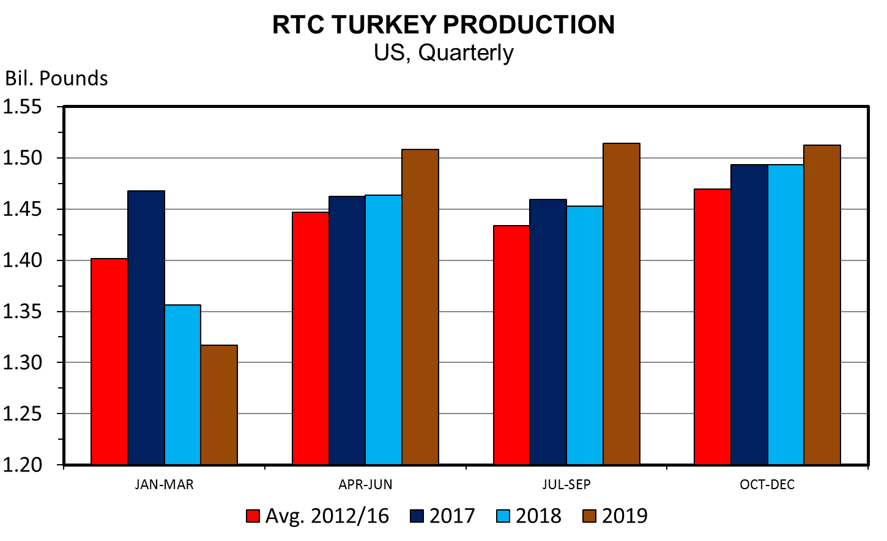
Accounts for 51% of meat disappearance in US
2018 will be 5th consecutive year of record setting production
Poultry supplies were 0.2 lb/capita smaller due to lower turkey production
Adding poultry slaughter capacity
Increase production
Increased reliance on exports
2017 exported 16% of production
Up approx. 1% over 2016
Mexico (-10%) big export market

Slide 5
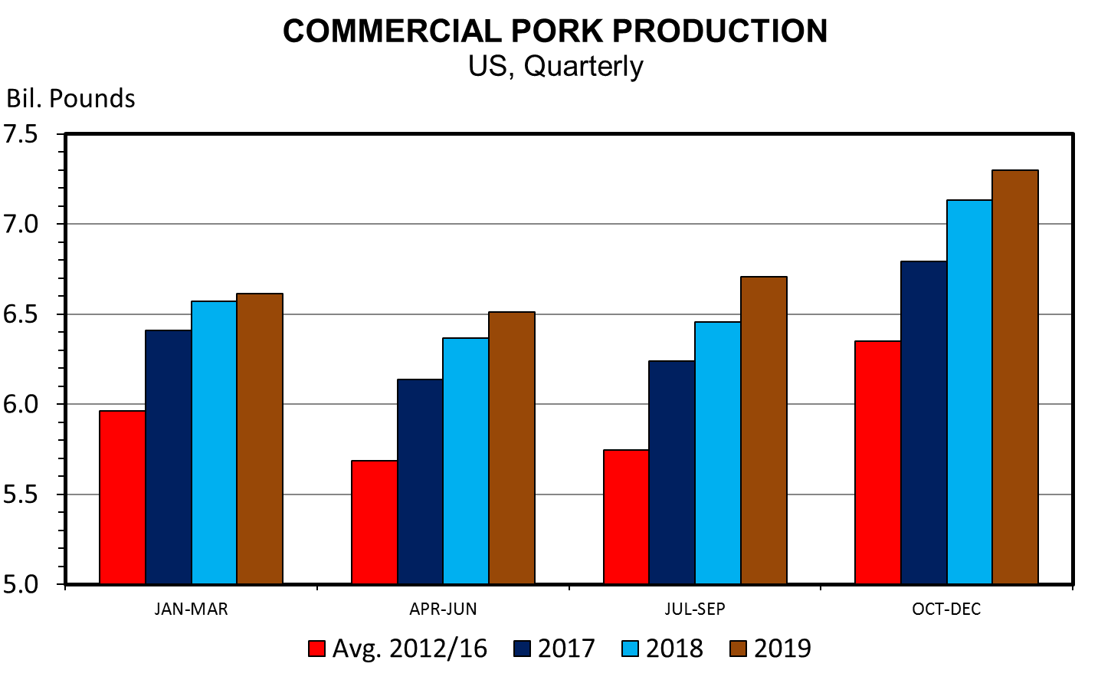
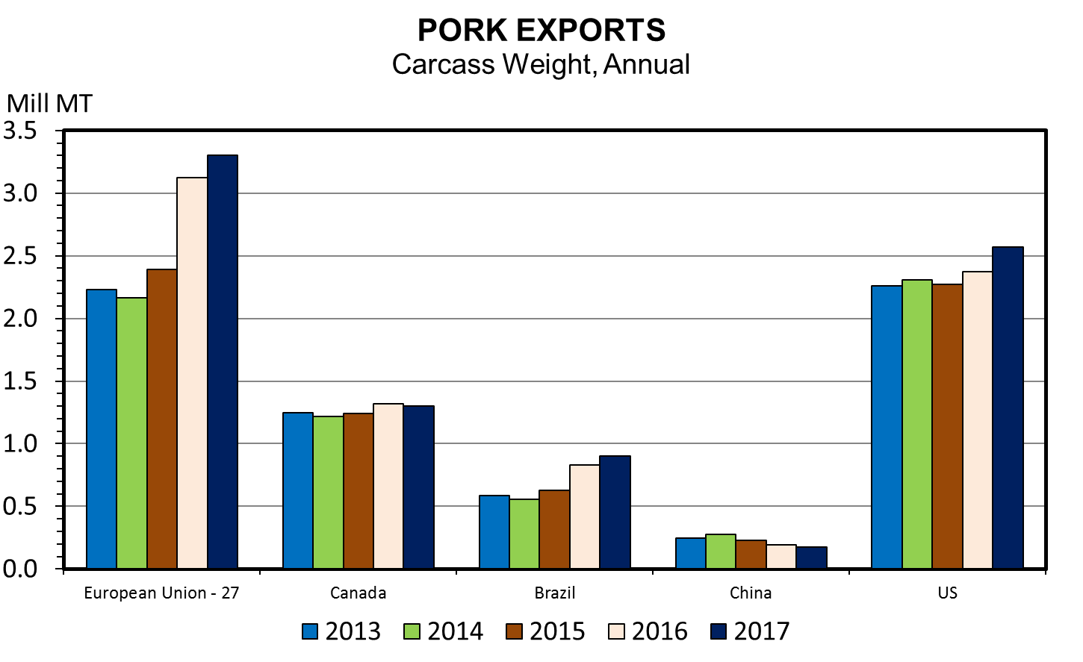
4th year of record production
2017 production up 0.8 lbs/capita
2018 up 1 lb per capita
Export 21% of pork production
+3.9% in 2017, +4% in 2018
2014 US exported 6.7% more weight than EU
2017 US exported 2.5% less weight than EU
7% less to Japan
17% increase to Mexico
24% increase to S. Korea

Slide 6
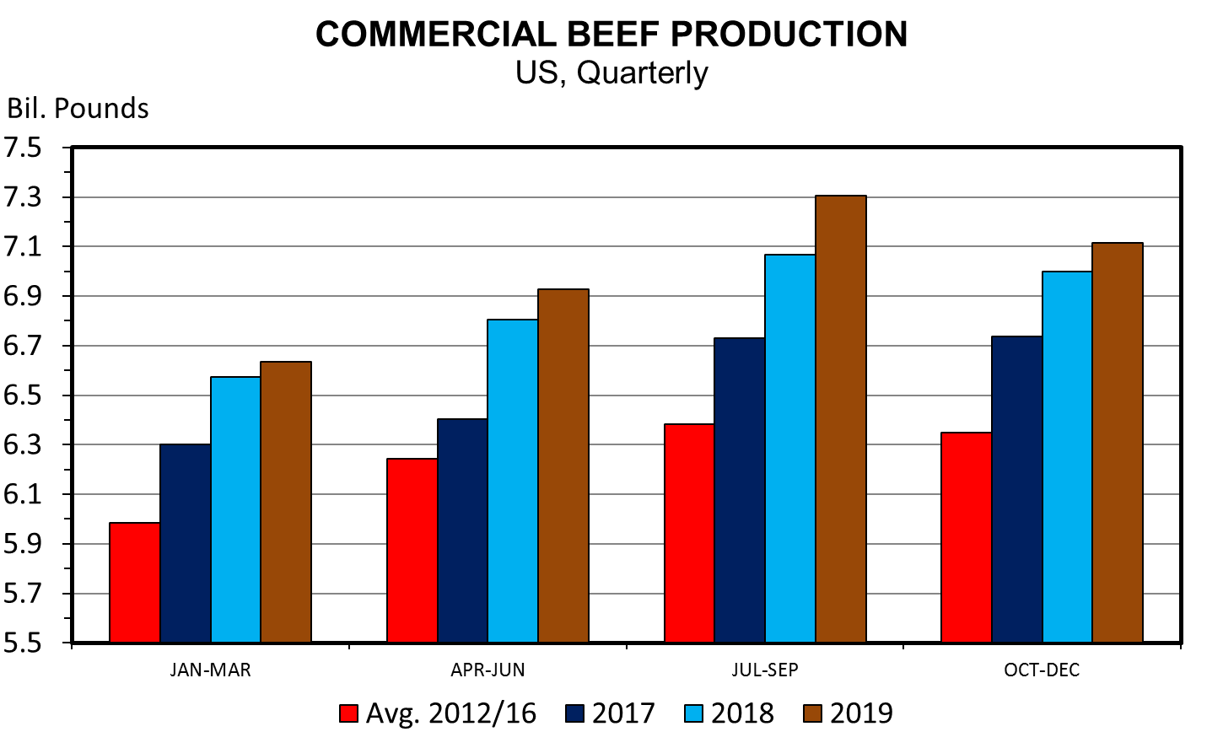
Beef production will grow faster than pork or poultry
Record production in 2018 (+3.8% in 2017, 4.9% in 2018)
Cattle herd will be up 650K to 94.2 million
Herd growth will remain at expansion levels

Slide 7
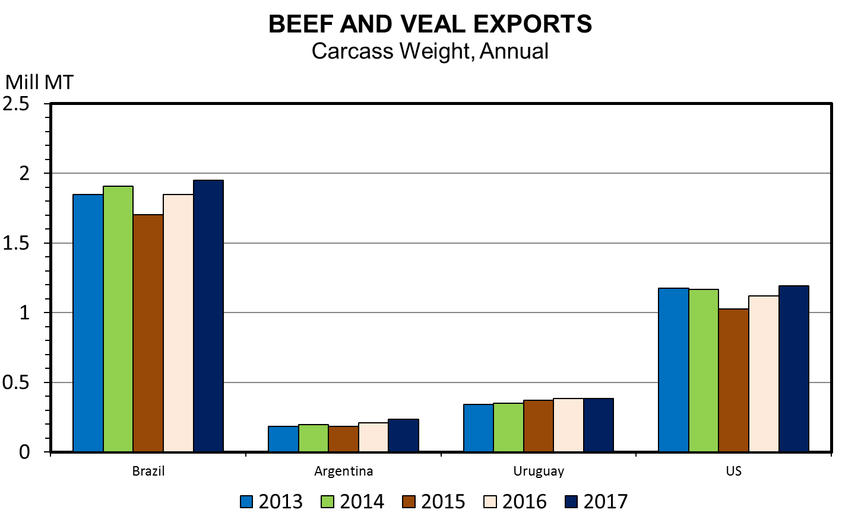
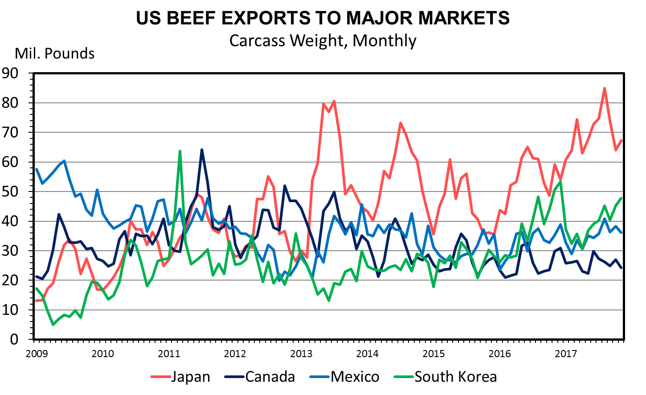
Beef Exports (+11% in 2017, +6% in 2018)
Japan +28% in 2017
Canada +2.3%
Mexico +7.5%
South Korea +6.1%
Where do US Beef Exports go?
Japan – 30%
South Korea – 22%
Hong Kong – 14%
Mexico 14%
Canada 8%

Slide 8
Where are we headed?
Cattle price outlook should be viewed as having potential to be much different than expectations shown here.
Feeding industry will remain current, but carcass weights will continue to increase
Loss in currentness will push feeder and calf prices lower
Expansion markets favors industry participants closer to the end user
Retail beef price will fall more than expansion beef production
Growing beef supplies but limited packer capacity means increased packer bargaining power

Slide 9
Where are we headed?
Feeders saw record profitability in 2017
Margins will shrink in 2018
Cow calf and feeder profitability will shrink
Continued volatility
2018 will see increased cattle herd

Slide 10
2018 Prices
 | Prod. | Exports | Price Direction
Broilers | Up | Up | Down
Turkey | Down
Pork | Up | Up | Hog prices
 |  |  | Q1 - down 1.2%
 |  |  | Q2 - up 0.5%
 |  |  | Q3 – down 3.6%
 |  |  | Q4 - down 5.6%
Beef | Up |  | Finished cattle | Yearlings | Calves
 |  |  | Q1 - down 2.4% | Q1 – up 13.6% | Q1 – up 5.4%
 |  |  | Q2 - down 7.7% | Q2 - down 1.5% | Q2 – down 2%
 |  |  | Q3 - down 3.1% | Q3 - down 8.1% | Q3 - down 3.9%
 |  |  | Q4 - up 4.6% | Q4 - down 12.2% | Q4 – down 10.9%

Slide 11
Soybeans

Slide 12
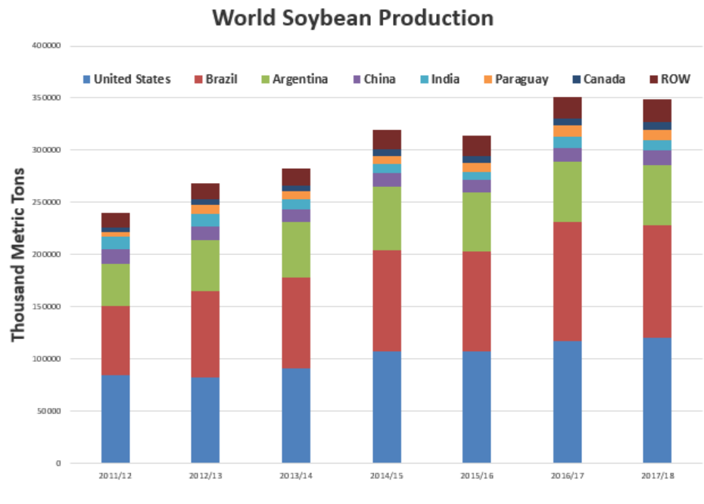
Soybeans
World production at 12.823 billion bushels
US production - 4.392 BB
Brazil production - 4.041 BB
Argentina production – 2.058 BB

Slide 13
Bullish Factors
2017/18 global demand is strong
US Crush is up 2.5 MB from last year (projected up 10 MB for MY)
Soybean Oil stocks are down 2% from October

Slide 14
Bearish Factors
Despite strong crush – meal and oil output is lower indicating lower quality
Brazilian growing conditions have been good
Brazilian consultants raise crop estimate
US share of Chinese market has dropped to 30%
USDA will likely revise projections lower
China tightens import specifications on soybeans
Only up to 1% FM
Current #2 soybeans allow 2% FM

Slide 15
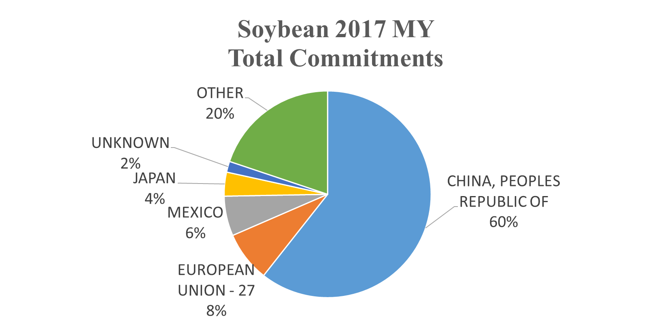
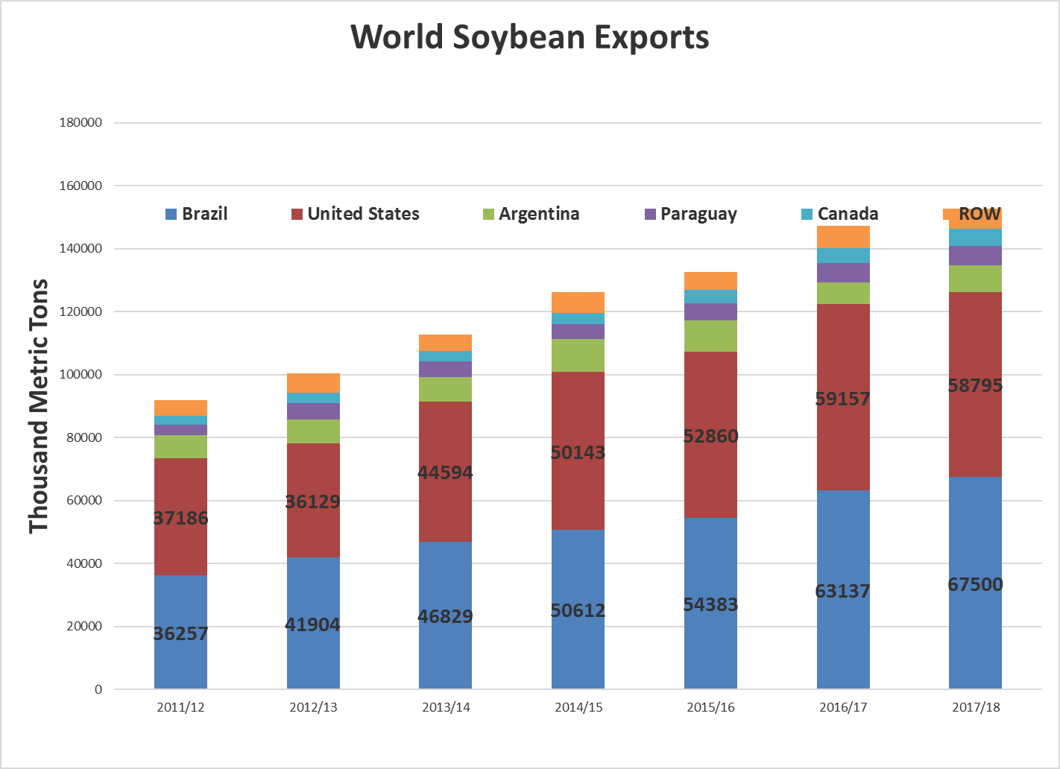
Total Commitments are down 15% to date
Exports to China are down 26% to date
USDA Projections
Brazil will be up 6.9%
US down 0.5%

Slide 16
Corn

Slide 17
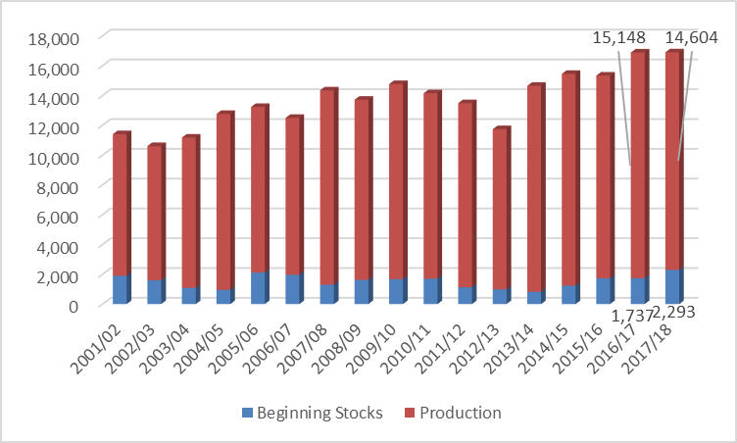
US Corn Supply
Total Supply = 16,947
Decreased corn acreage planted/harvested of 3.8 M
Supply is stable YoY but demand is down 1%
Carryover will increase 6.8%

Slide 18
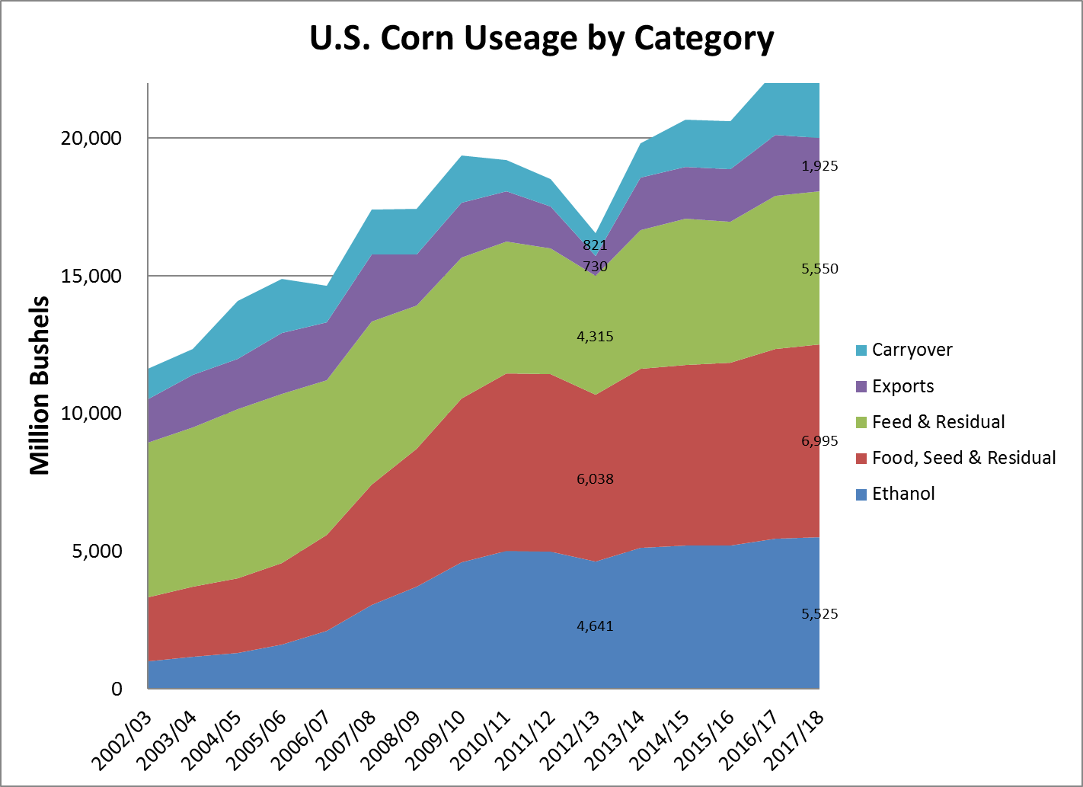
Feed and Residual stable
Ethanol down 1.4%
Exports down 13.5%

Slide 19
US Ethanol Production
Through first 3 months of MY, on pace to have 5.550 BB, up 25 MB than USDA projection
Production decreased 58,000 bpd in December
First time below last year since Aug 4
US exported 93.6 million gallons in October, up 7.2 million gallons (8.3%) from September
Down 24.3% YoY
Exports decreasing
Shipments to Brazil lower after 20% tariff implemented and China implemented 30% tariff

Slide 20
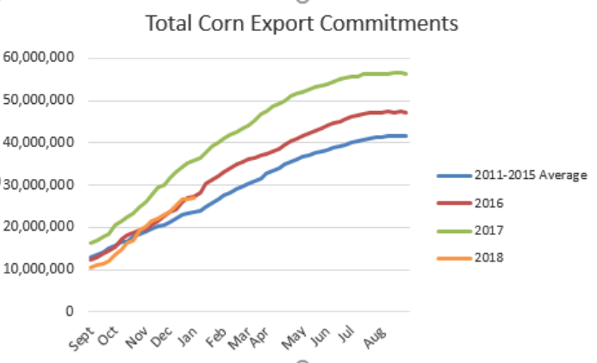
US Corn Exports
2017/18 MY - commitments down 23%, outstanding sales down 15%
Mexico commitments down 2.6%, outstanding sales down 15%
Korea commitments down 60%, outstanding sales down 25%
Japan commitments down 14.5%, outstanding sales up 10%

Slide 21
Bearish Factors
Bullish Factors
Increased cattle on feed
Slightly lower acres for 17/18 MY
Dry weather in Argentina and persistent La Nina effects
Strong demand is already factored into price
Weaker exports

Slide 22
Thoughts for 2018 and beyond
Supply/demand concerns
Large crops
Corn markets have adjusted downward to absorb supplies
Soybean market is still overpriced
Limited upside potential for price
To make a move up need bullish news, but to continue down need no new news

Slide 23
Where will prices go for 2018?
Corn
Dependent on acreage and mother nature
Likely see a decrease in acreage
Trend yield of 172.1 bu/acre
Harvested acres of 82.5 M
14.3 BB production + 2.477 BB carryover + 40 MB imports = 16.794 BB supply
Maintain current demand
Stocks to use = 15.3% - current is 17.1%
Cash prices would be similar to 2017 harvest price and potentially $0.10 higher

Slide 24
Where will prices go for 2018?
Soybean
Likely see an increase in acreage
Trend yield of 47.6
Harvested acres of 90.2 M
14.3 BB production + 2.477 BB carryover + 40 MB imports = 16.794 BB supply
Maintain current demand
Stocks to use = 14.6%, current is 11%
Cash prices could be as low as $8.46 at harvest

Slide 25
Things to watch in 2018
Argentina export tax decrease by 0.5% each month starting in 2018
This will increase export pressure from Argentina
Value of dollar beginning to increase
Economy at near full employment
Wage growth is strong
China?
Importing less soybeans
Changing specifications for soybean imports
Leaving NAFTA?
Talks begin Jan 23
Bilateral Talks

Slide 26
Thank you!
Any Questions?
Brenda.Boetel@uwrf.edu
Sources
Data: LMIC, USDA-NASS, USDA-FAS

